Slide 1
The Impact of The human psyche on Financial Well-Being

Slide 2
The Overarching Question:

Slide 3
How do Specific Psychological Differences* Impact an Individual’s Financial Well-Being?
*For purpose of An all-inclusive research question, the cognitive nature of Financial knowledge has been framed as a Psychological characteristic

Slide 4
Data sourced from:
The National Financial Well-Being Survey – Public Use file codebook
A Study Conducted September 2017

Slide 5
Review of related Work
“Delphi Study of Experts’ Rankings of Personal Finance Concepts Important in the Development of the InCharge Financial Distress/Financial Well-Being Scale”
- From Consumer Interest Annual, 2005
This study was conducted to identify concepts recommended by financial experts instead of a generalized population. With a survey assessment questionnaire and an expert research panel, the researchers discovered a multitude of points of reference for understanding an individual’s financial well-being, including stress, satisfaction, and financial knowledge – all of which were present in my data prior to examination of this data.
The study was conducted predominantly around self-control with multiple response variables used in order to understand financial well-being. The study also used a subjective questionnaire to collect data. In the end the researchers, concluded that self-control does have a positive effect on savings and general financial behavior.
The study utilized close-ended questionnaires over self-control, financial behavior and financial literacy similar to my own. They concluded a bigger study needed to be conducted, yet, they included consumers and businesses could still benefit from understanding personality and psyche in financial influences.
“Does Self-Control Predict Financial Behavior and Financial Well-Being?”
- From Journal of Behavioral and Experimental Finance, Elsevier, 5 May 2017
“Impact of Self-Control, Financial Literacy and Financial Behavior on Financial Well-Being”
- From The Journal of Social Sciences Research, 2019

Slide 6
The Model building Process
Gather the Data & Define Variables
Clean the Data for Proper Use
Split Data & Build New Models from Test/Training Sets
Compare Test/Training Sets
Build Final Model
Check Assumptions
Transform Model & Remove Outliers*
Perform Regression & Inference Analysis
*Fortunately for my model, no transformations were needed, and only minor outliers appeared

Slide 7
The codebook

Slide 8
The Codebook
Variable | Label | Description | Variable Type | Variable of Interest
DelayGrat | Ability to Delay Gratification | Depicts the ability of the person to delay gratification with self-control | Categorical | Explanatory
Diligence | Trait of Diligence | Depicts a person’s ability to act diligently | Categorical | Explanatory
Distress | Level of Perceived Stress | Describes a person’s level of stress | Categorical | Explanatory
Effort | Influence of Effort | Depicts a person’s attitude toward the use of effort in work | Categorical | Explanatory
FSscore | Financial skill scale score | Measures financial skills and knowledge, preliminary score used by CFPB research | Quantitative | Explanatory
FWBscore | Financial well-being score | Measures a person’s financial well-being based on 10 financial question | Quantitative | Response
Impress | Appeal to Material impression | Depicts a person’s value on the impression of material things | Categorical | Explanatory
Impulse | Self-control of impulse | Describes a person’s ability to control impulse | Categorical | Explanatory
KHscore | Knoll and Houts financial scale score | Measures a person’s financial knowledge based on IRT, Knoll and Houts | Quantitative | Explanatory
LMscore | Lusardi and Mitchell knowledge scale score | Measures a person’s financial knowledge based on the National Bureau of Economic Research | Quantitative | Explanatory
LuxAdm | Appeal to Material Luxury | Describes a person’s value of luxurious and expensive material things | Categorical | Explanatory
Optimism | Trait of Optimism | Depicts a person’s trait of Optimism | Categorical | Explanatory
PsyConnect | Psychological Connectedness | Describes the degree at which a person feels connected to their future self | Categorical | Explanatory
Satisfaction | Perceived satisfaction with life | Depicts a person’s relative life satisfaction | Categorical | Explanatory
Things | Value of material things | Describes a person’s value of material things and their trait of materialism | Categorical | Explanatory

Slide 9
The Response Variable:
Financial Well-Being Scale Score (FWBscore)
Derived From “CFPB Financial Well-Being Scale: Scale development technical report”
The Financial Well-Being Scale Score is a quantitative variable sourced from a technical survey report based on a financial scale.
The Financial Well-Being Scale Score was picked due to its anticipated well-representation of a person’s collective well-being in their financial area of life, in addition to its quantitative nature.

Slide 10
THE EXPLANATORY VARIABLES: FINAL MODEL
LMscore
PsyConnect
Quantitative Varible
The Lusardi and Mitchell financial knowledge scale score
Summative scale score for a 3-item financial knowledge scale, presented in Lusardi, Annamaria and Olivia S. Mitchell
Quantitative Variable; measured on scale
Psychological Connectedness
The feeling of relation towards an individual’s future self and the degree at which they are similar to their present identity, demonstrating more feelings of connectedness to the future self, or drastically different, demonstrating less feelings of connectedness to their future self.

Slide 11
THE EXPLANATORY VARIABLES: FINAL MODEL
Satisfaction
DelayGrat
Categorical Variable
Taken as a measurement of an individual’s level of agreement response to the statement: “I am satisfied with my life.”
Describes a person’s overall relative life satisfaction
Categorical Variable
An evaluation of whether or not the individual agrees with the statement, “I am good at resisting temptation.”
Depicts the ability of the individual to delay gratification with self-control

Slide 12
THE EXPLANATORY VARIABLES: FINAL MODEL
Diligence
Distress
Categorical Variable
An evaluation of whether or not an individual agrees with the statement, “I am able to work diligently toward long-term goals.”
Depicts an individual’s ability to act diligently
Categorical Variable
A self-evaluation of an individual’s stress level

Slide 13
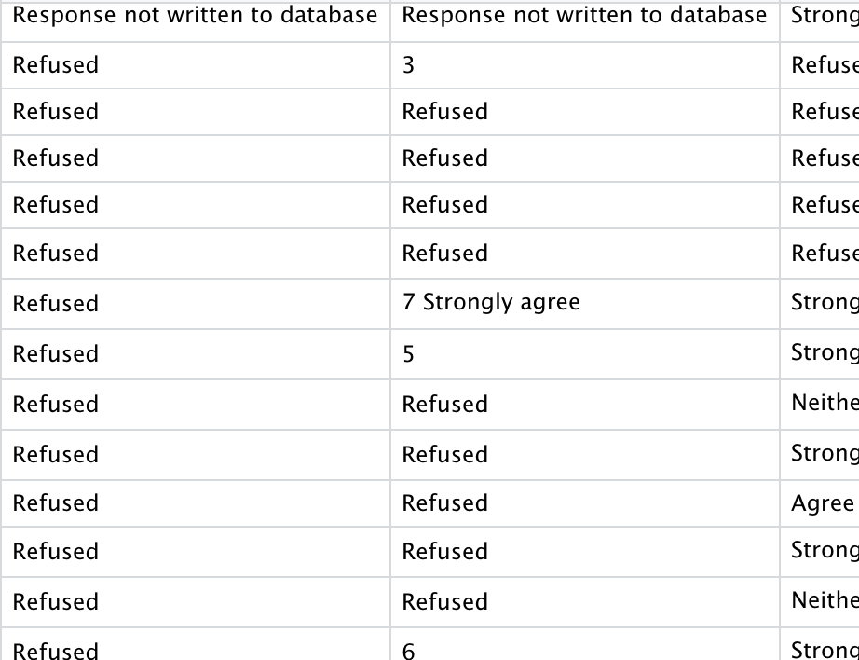
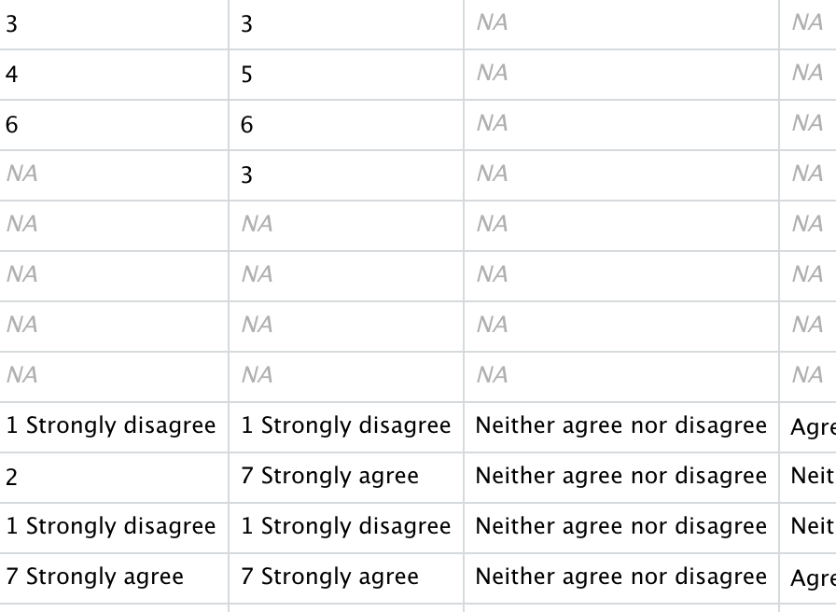
Data Cleaning
Replaced all data with “Refused” and “Response not written to database” with NA

Slide 14

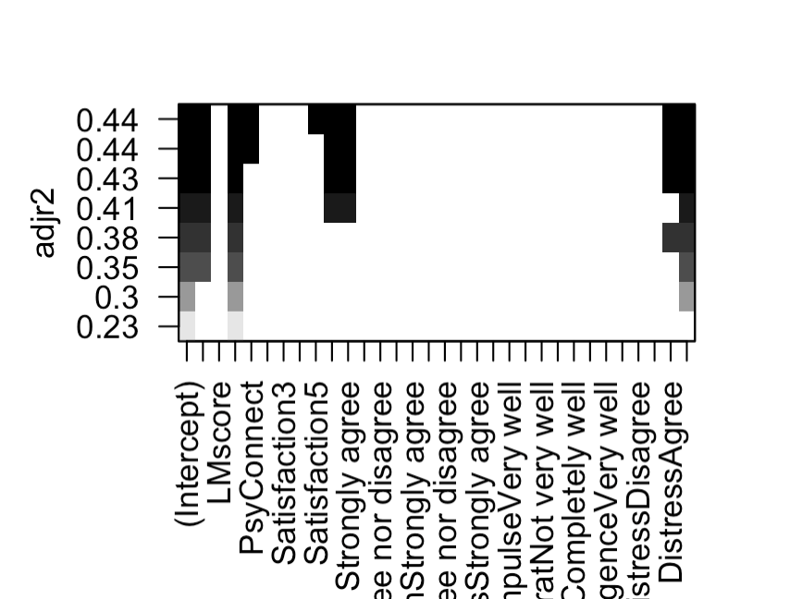
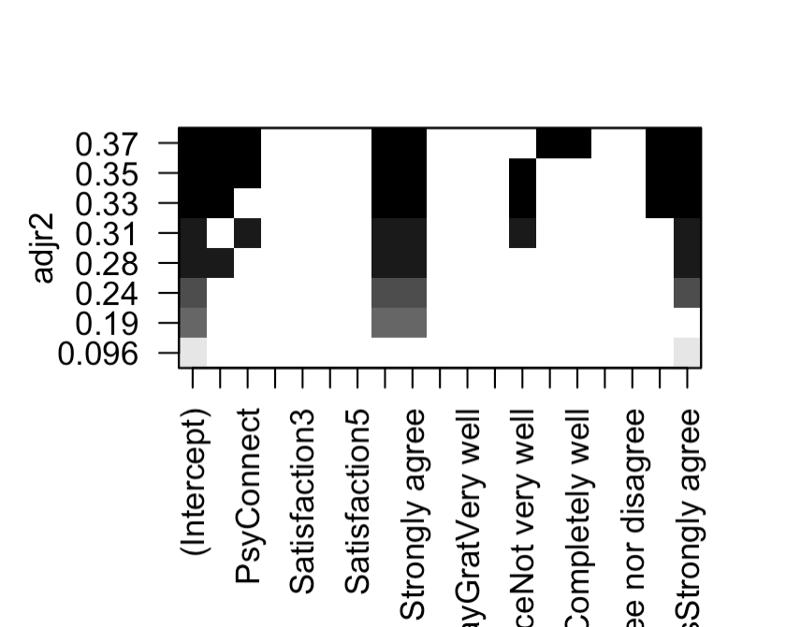
THE EXPLANATORY VARIABLES: UNUSED
KHscore: Knoll and Houts financial knowledge scale score
Disregarded due to minor collinearity with LMscore and higher p-value
FSscore: Financial Skill Score
Disregarded due to minor collinearity with LMscore and higher p-value
Optimism
Disregarded due to need for parsimoniousness and low Adjusted R^2
Effort
Disregarded due to need for parsimoniousness and low Adjusted R^2
Lux-Admiration: Admiration of luxury goods
Disregarded due to Collinearity with other variables
Things: Determination of material things to dictate one’s life
Disregarded due to need for parsimoniousness and low Adjusted R^2
Impulse: Degree of acting without thinking
Disregarded due to Collinearity with Delay Gratification and need for parsimoniousness

Slide 15
RESEARCH METHODS: DATA SPLIT
Variables | VIF
KHscore | 1.696309
LMscore | 1.583421
FSscore | 1.601100
PsyConnect | 1.197648
Satisfaction | 1.613591
LuxAdm | 2.820022
Impress | 2.870876
Impulse | 1.406995
DelayGrat | 1.885515
Diligence | 1.969964
Distress | 1.428729
Delineated which variables were Collinear and had high/low Adjusted R^2 from Training Model

Slide 16
FIRST training Model: Summary

Slide 17
Variables | Coefficients | Std. Error | t-value | P-value
(Intercept) | 23.571952 | 1.830298 | 12.879 | < 2e-16
KHscore | 2.902571 | 0.252354 | 11.502 | < 2e-16
LMscore | 0.483938 | 0.264306 | 1.831 | 0.067173
FSscore | 0.291640 | 0.015792 | 18.468 | < 2e-16
PsyConnect | 0.044634 | 0.007114 | 6.274 | 3.87e-10
Satisfaction2 | 2.233592 | 1.378776 | 1.620 | 0.105310
Satisfaction3 | 2.453842 | 1.188210 | 2.065 | 0.038968
Satisfaction4 | 3.771467 | 1.067913 | 3.532 | 0.000417
Satisfaction5 | 6.160929 | 1.036613 | 5.943 | 3.02e-09
Satisfaction6 | 9.837861 | 1.048803 | 9.477 | < 2e-16
Satisfaction7 Strongly Agree | 11.406345 | 0.549074 | 10.876 | < 2e-16
LuxAdm Disagree | 0.869129 | 0.548136 | 1.583 | 0.113519
LuxAdm Neither agree nor disagree | 0.664138 | 0.674581 | 1.212 | 0.225721
LuxAdm Agree | -0.386331 | 1.048203 | -0.573 | 0.566879
LuxAdm Strongly agree | -4.019133 | 0.490630 | -3.834 | 0.000128
Impress Disagree | 0.314397 | 0.525249 | 0.641 | 0.521685

Slide 18
Variables | Coefficients | Std. Error | t-value | P-value
Impress Neither agree nor disagree | 0.209405 | 0.525249 | 0.399 | 0.690150
Impress Agree | 0.316383 | 0.684159 | 0.462 | 0.643789
Impress Strongly Agree | -0.733503 | 1.273707 | -0.576 | 0.564726
Impulse Not very well | 0.131359 | 0.380117 | 0.346 | 0.729679
Impulse Very well | -0.119151 | 0.489689 | -0.243 | 0.807769
Impulse Completely Well | -3.545708 | 0.912745 | -3.885 | 0.000104
DelayGrat Not very well | -1.039491 | 1.043497 | -0.996 | 0.319228
DelayGrat Very well | -1.172663 | 1.028905 | -1.140 | 0.254467
DelayGrat Complelely well | -1.494573 | 1.101030 | -1.357 | 0.174716
Diligence Not very well | 0.391852 | 1.216130 | 0.322 | 0.747308
Diligence Very well | 3.081278 | 1.186609 | 2.597 | 0.009444
Diligence Completely well | 4.384420 | 1.239440 | 3.537 | 0.000408
Distress Disagree | -3.015012 | 0.714349 | -4.221 | 2.49e-05
Distress Neither agree nor disagree | 0.706279 | 0.706279 | -6.923 | 5.09e-12
Distress Agree | -7.923820 | 0.725587 | -10.921 | < 2e-16
Distress Strongly Agree | -12.228921 | 0.829075 | -14.750 | < 2e-16

Slide 19

FIRST training Model: Summary
Data Type | Values
Degrees of Freedom | 4271
Residual Standard Error | 10.18
Multiple R^2 | 0.469
Adjusted R^2 | 0.4651
F-Statistic | 121.7
P-Value | < 2.2e-16

Slide 20
RESEARCH METHODS: DATA SPLIT PART 2
Final Variables Realized after parsimonious removal of other variables due to low adjusted R^2, high p-value and judgement calls
Variable | VIF
LMscore | 1.108796
PsyConnect | 1.115974
Satisfaction | 1.458775
DelayGrat | 1.619106
Diligence | 1.703080
Distress | 1.337791

Slide 21
SECOND TRAINING MODEL SUMMARY

Slide 22
Variables | Coefficients | Std. Error | t-value | P-value
(Intercept) | 22.737070 | 1.749358 | 12.997 | < 2e-16
LMscore | 2.553433 | 0.232777 | 10.969 | < 2e-16
PsyConnect | 0.069884 | 0.007025 | 9.948 | < 2e-16
Satisfaction2 | 4.624614 | 1.452652 | 3.184 | 0.001465
Satisfaction3 | 4.352804 | 1.245364 | 3.495 | 0.000478
Satisfaction4 | 5.318207 | 1.116169 | 4.765 | 1.95e-06
Satisfaction5 | 8.592522 | 1.082741 | 7.936 | 2.63e-15
Satisfaction6 | 12.704118 | 1.082493 | 11.736 | < 2e-16
Satisfaction7 | 14.821706 | 1.090184 | 13.596 | < 2e-16
DelayGrat Not Very Well | 1.044828 | 1.097680 | 0.952 | 0.341225

Slide 23
Variables | Coefficients | Std. Error | t-value | P-value
DelayGrat Very Well | 2.189832 | 1.076153 | 2.035 | 0.041924
DelayGrat Completely Well | 2.561532 | 1.147124 | 2.233 | 0.025599
Diligence Not very well | 0.780536 | 1.264411 | 0.617 | 0.537061
Diligence Very well | 5.344811 | 1.227194 | 4.355 | 1.36e-05
Diligence Completely Well | 8.548546 | 1.269524 | 6.734 | 1.87e-11
Distress Disagree | -2.595926 | 0.748532 | -3.468 | 0.000529
Distress Neither agree nor Disagree | -5.423345 | 0.740002 | -7.329 | 2.75e-13
Distress Agree | -8.638280 | 0.758657 | -11.386 | < 2e-16
Distress Strongly Agree | -13.438450 | 0.865933 | -15.519 | < 2e-16

Slide 24
SECOND TRAINING MODEL SUMMARY
Data Type | Values
Degrees of Freedom | 4392
Residual Standard Error | 10.88
Multiple R^2 | 0.3927
Adjusted R^2 | 0.3902
F-Statistic | 157.8
P-Value | < 2.2e-16

Slide 25
Comparing test / training models
Name | Label | Values
Training Set MAE | train_mae | 8.461944
Test Set MAE | test_mae | 8.372948
MAE Difference | mae_diff | 0.08899679
Training Set R^2 | train_rsq | 0.3926701
Test Set R^2 | test_rsq | 0.4142107
R^2 Difference | rsquared_diff | 0.02154058
Actual FWB from Training Set | actual_FWB | 25
Predicted FWB | fit_FWB | 33.49863
FWB Residual | resid | -8.49863

Slide 26
CHEcking assumptions of the final model

Slide 27
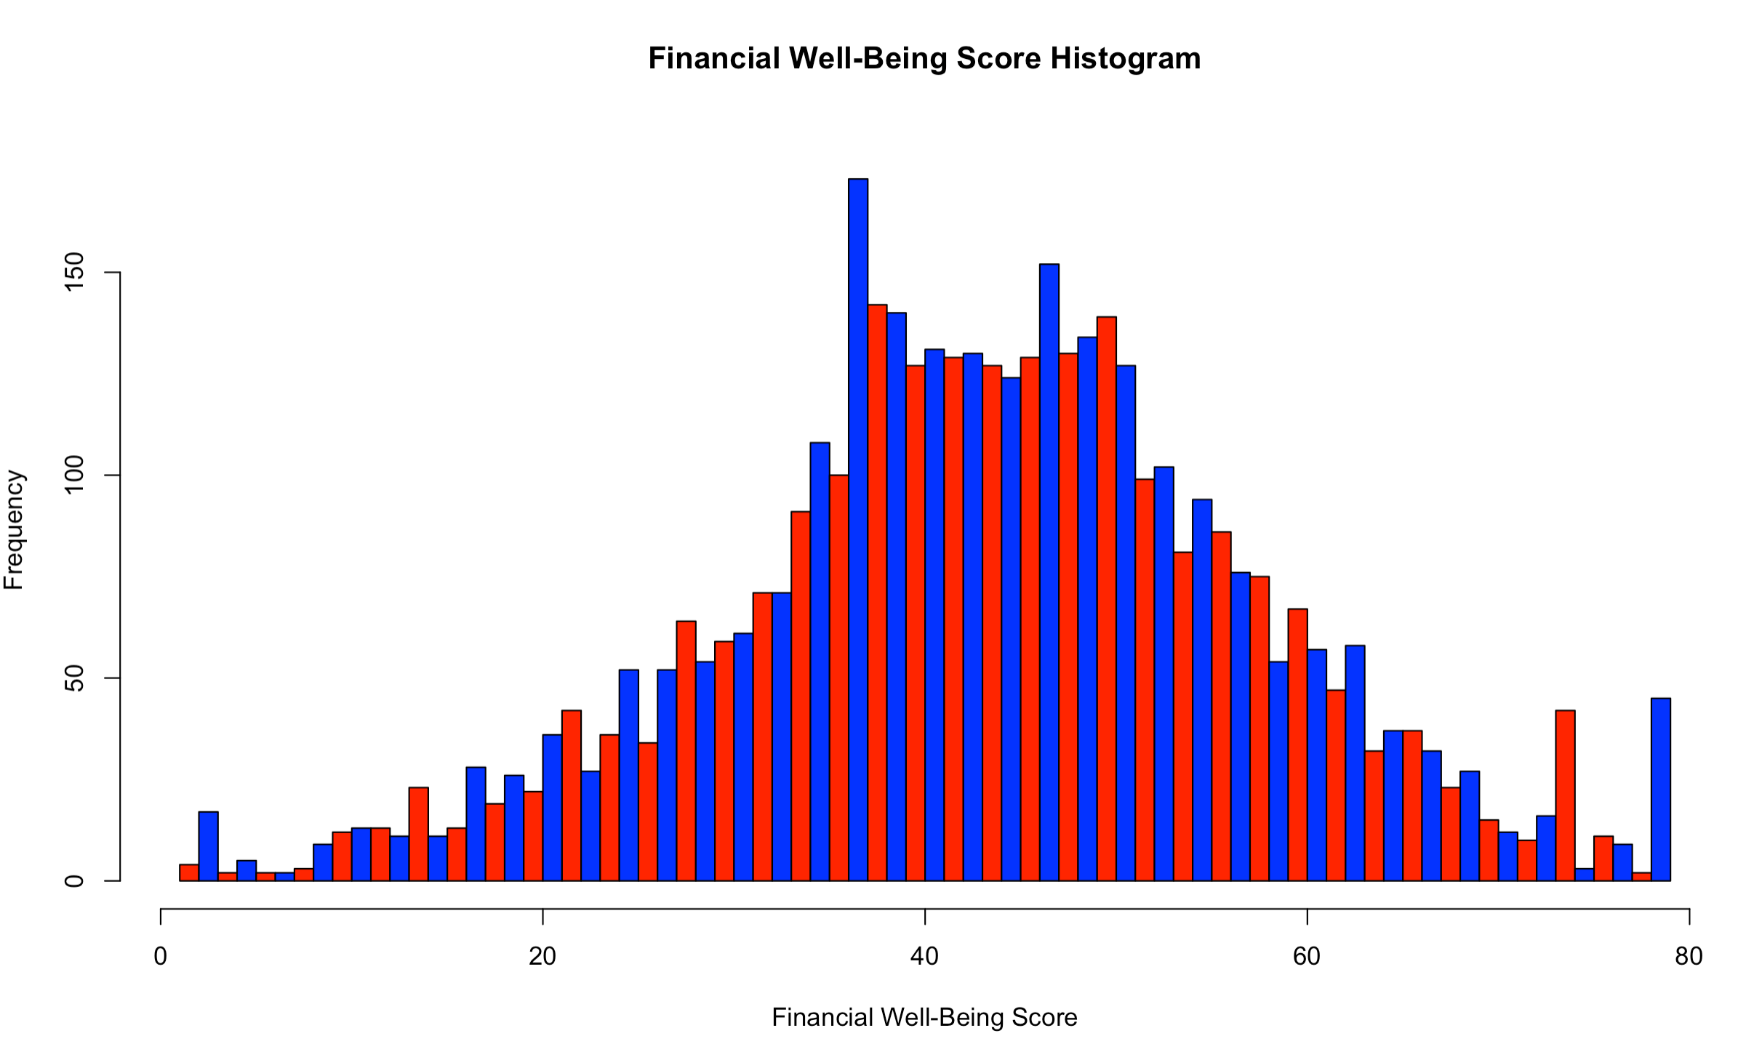
FWBscore

Slide 28
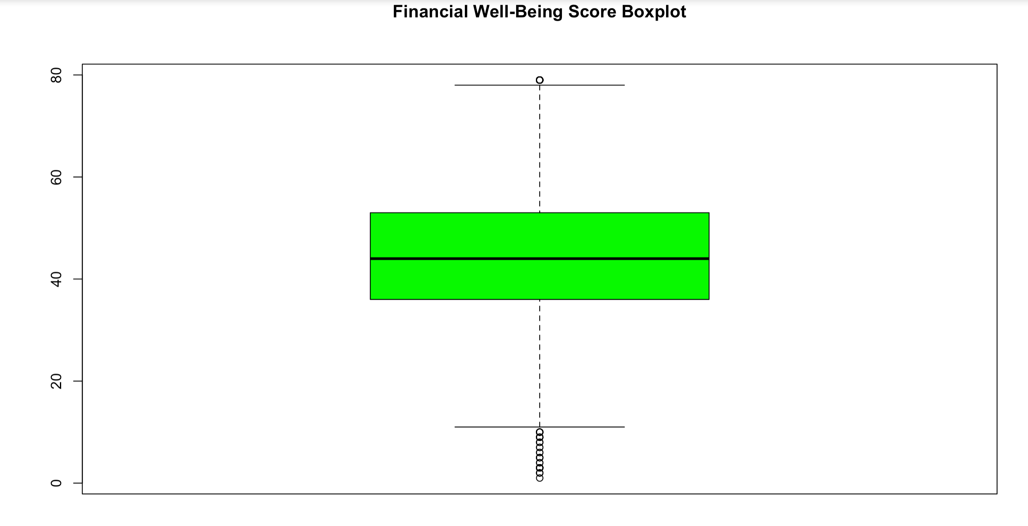
FWBscore

Slide 29
FWBscore
Name | Value
Min | 1
1st Quartile | 36
Median | 44
3rd Quarter | 44
Max | 53
Mean | 79
Standard Deviation | 13.97729
Skewness | -0.09243553
Kurtosis | 3.159658

Slide 30
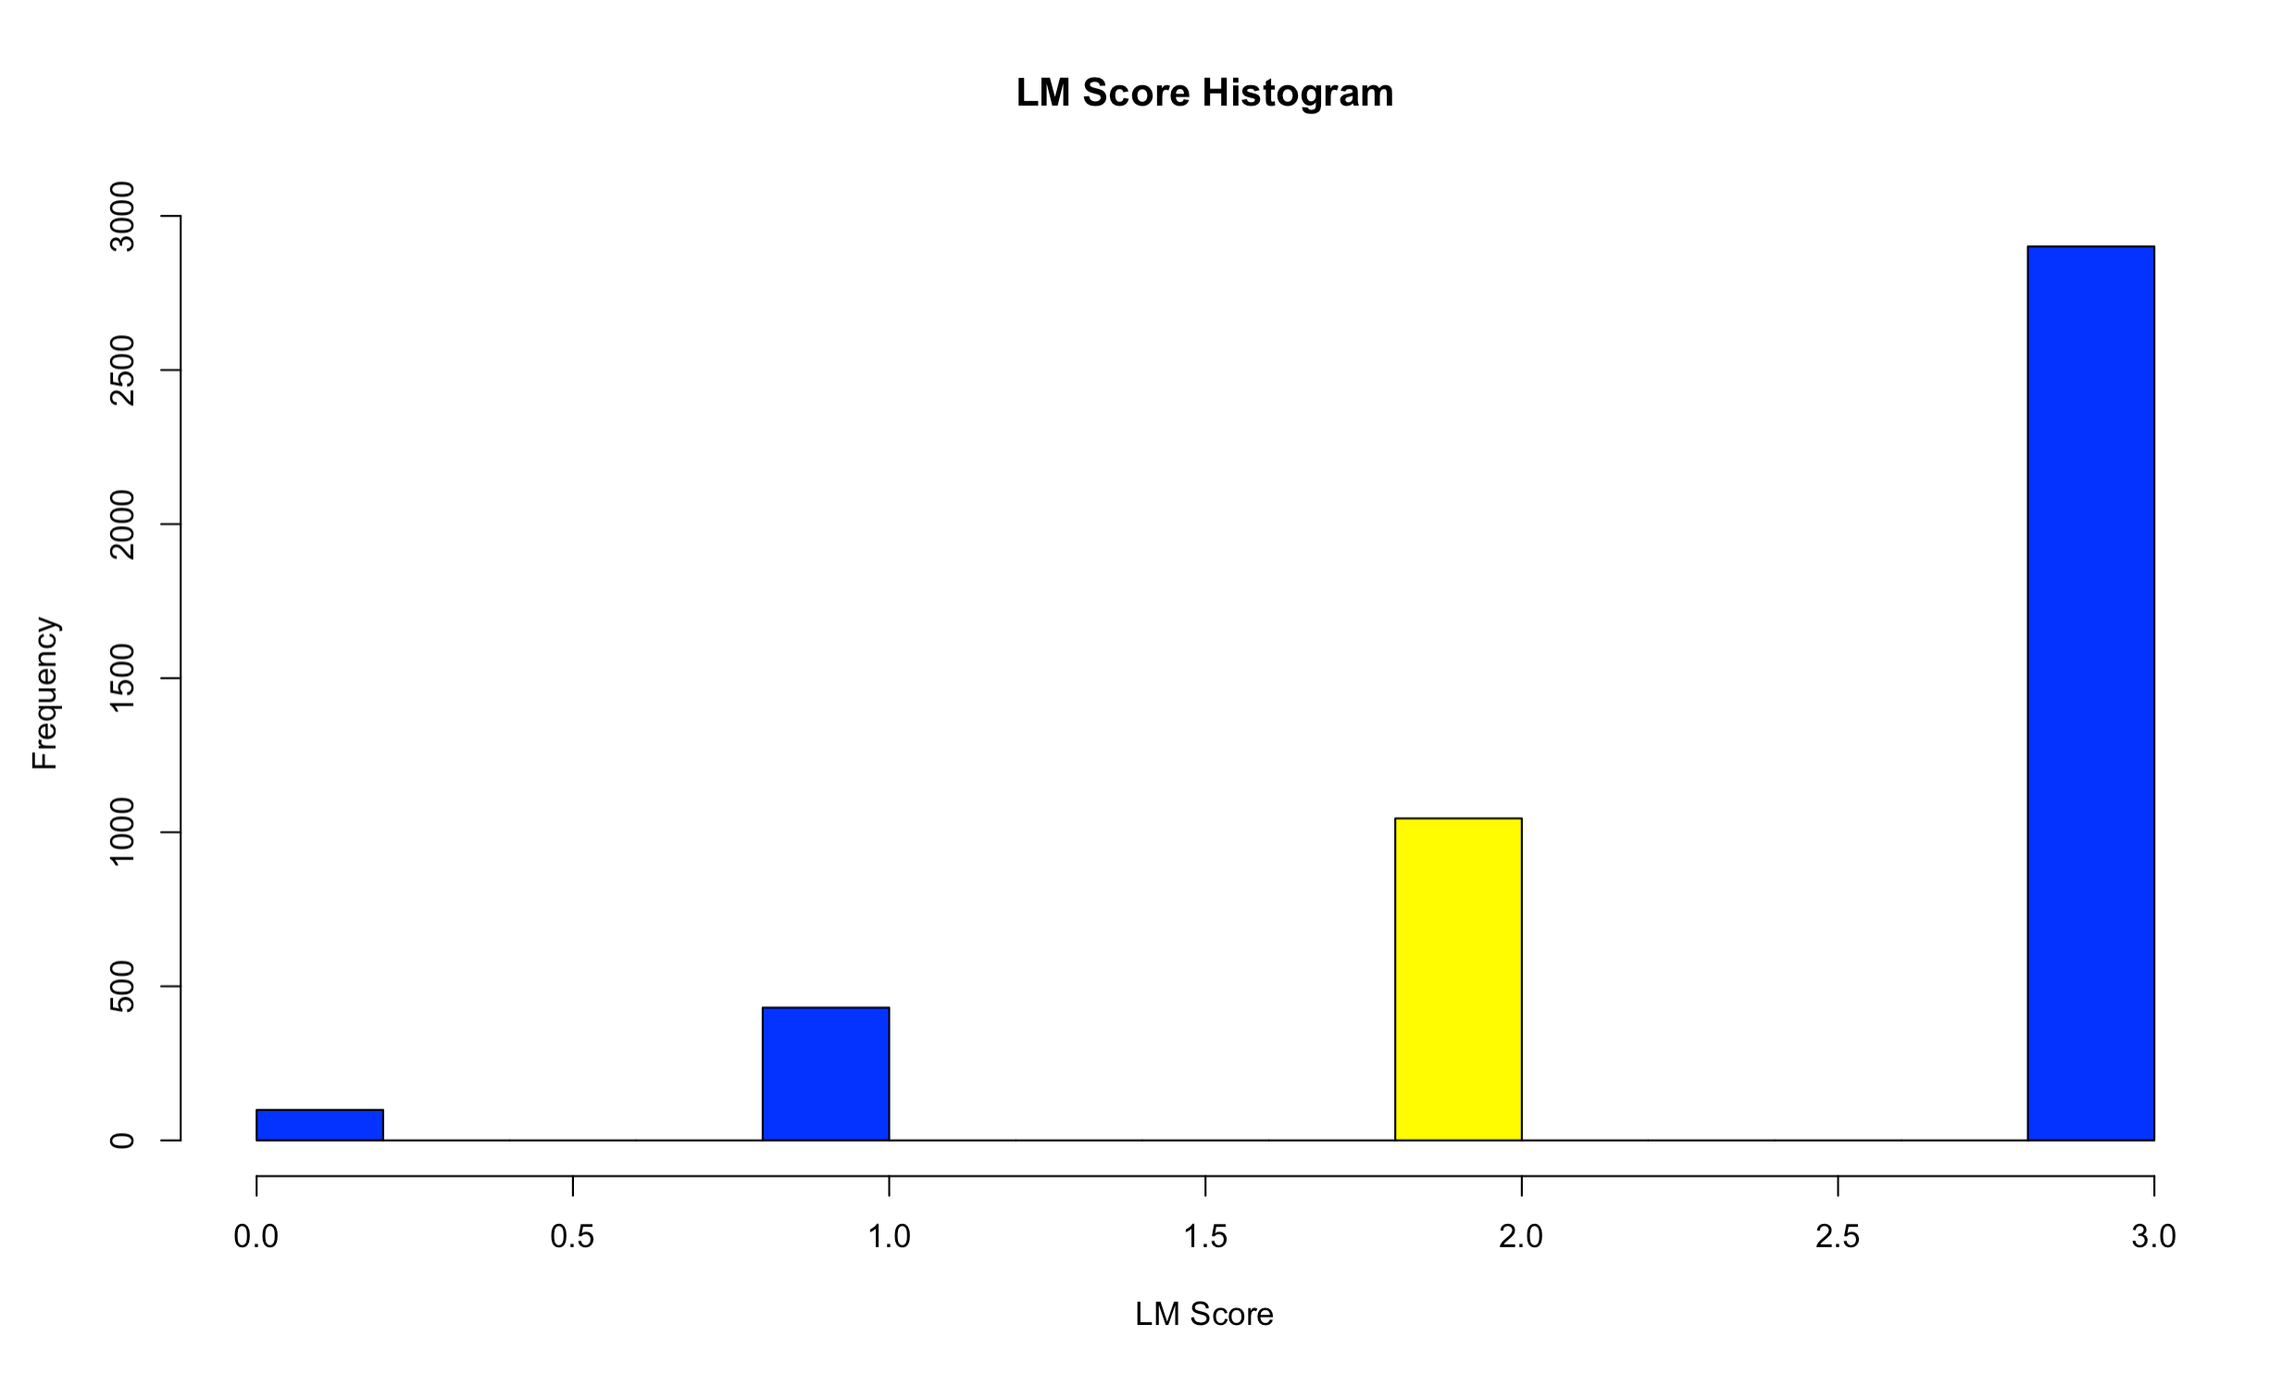
LMSCORE
Skewness | -1.448275
Kurtosis | 4.308214

Slide 31
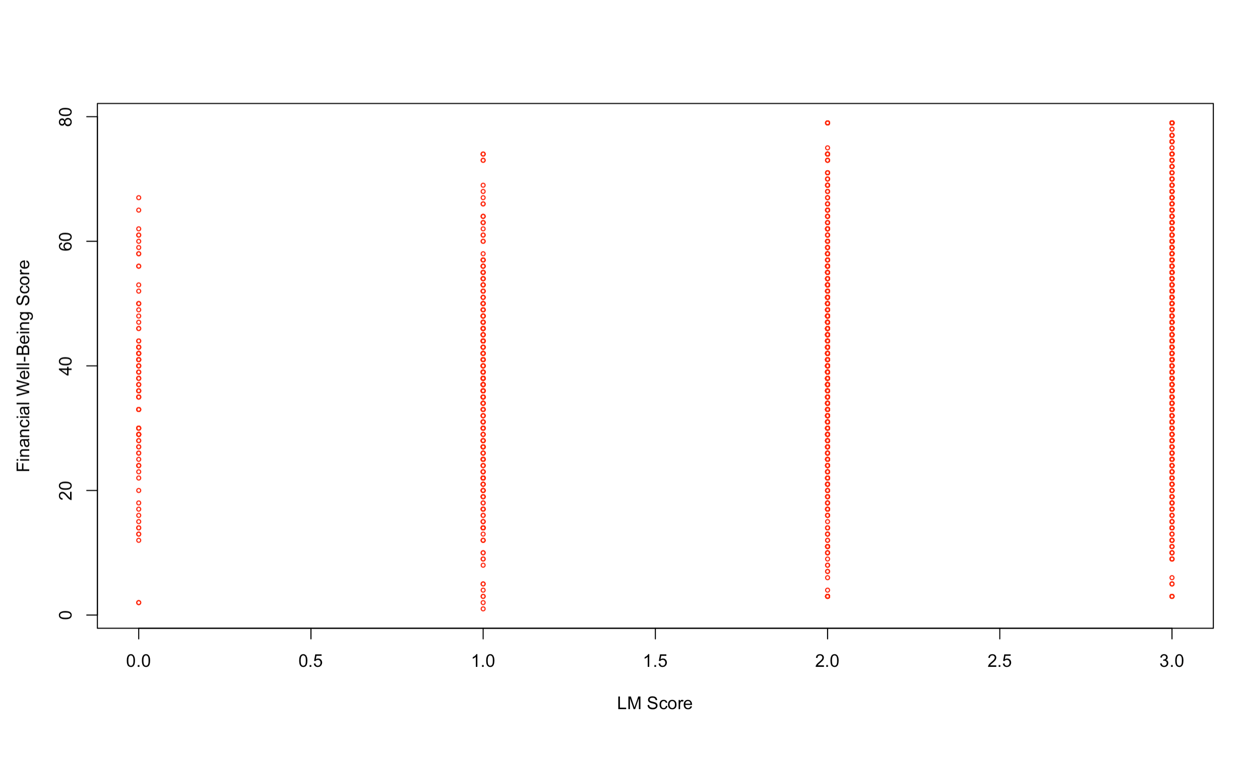
LMSCORE vs. FWBSCORE

Slide 32
LMSCORE vs. FWBSCORE
Name | Value
R | 0.2307611
Min | 0
1st Quartile | 2
Median | 3
Mean | 2.508
3rd Quartile | 3
Max | 3
Standard Deviation | 0.7585257

Slide 33
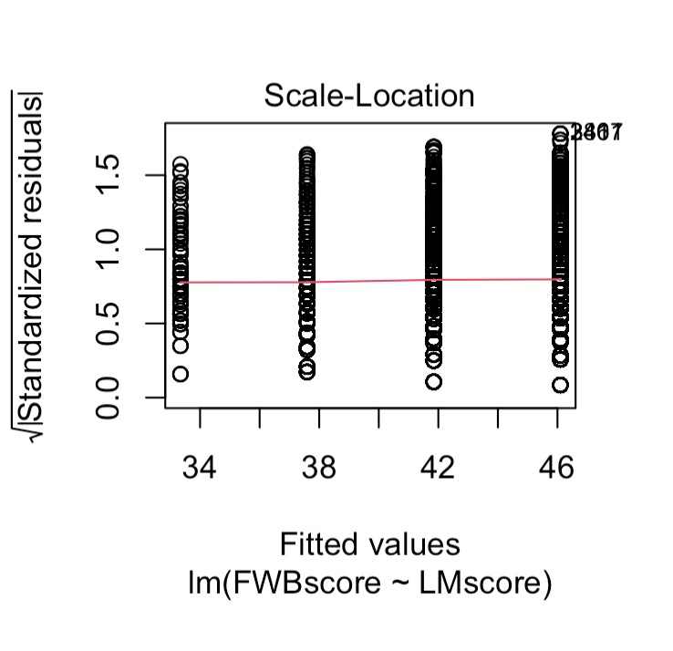
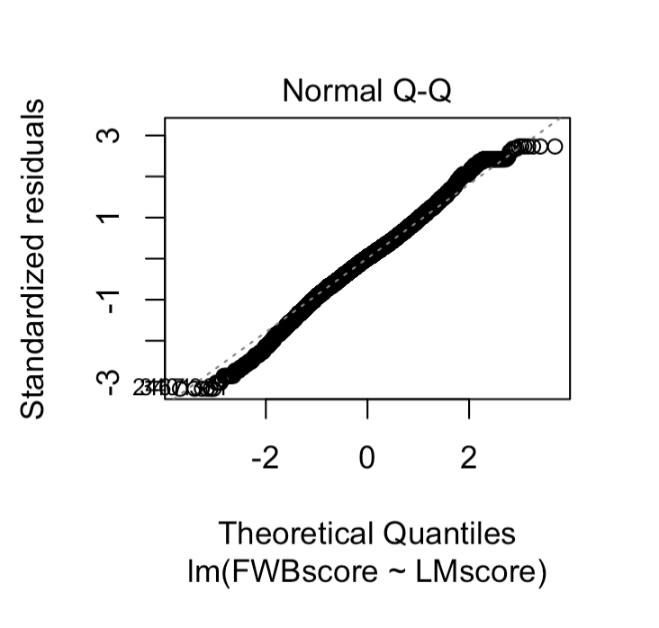
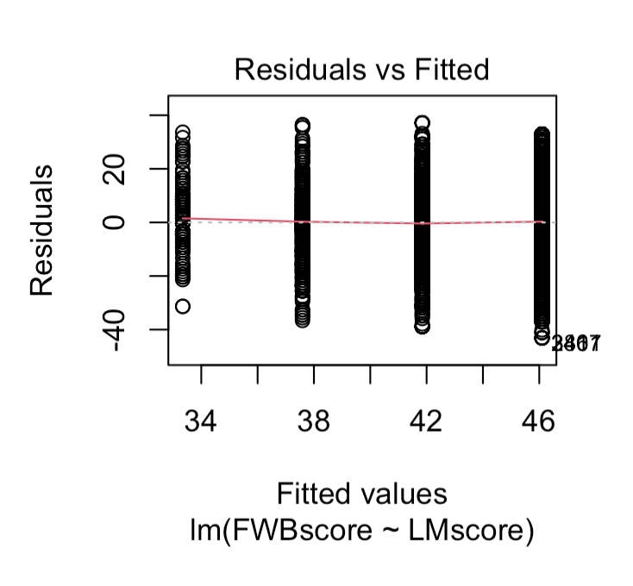
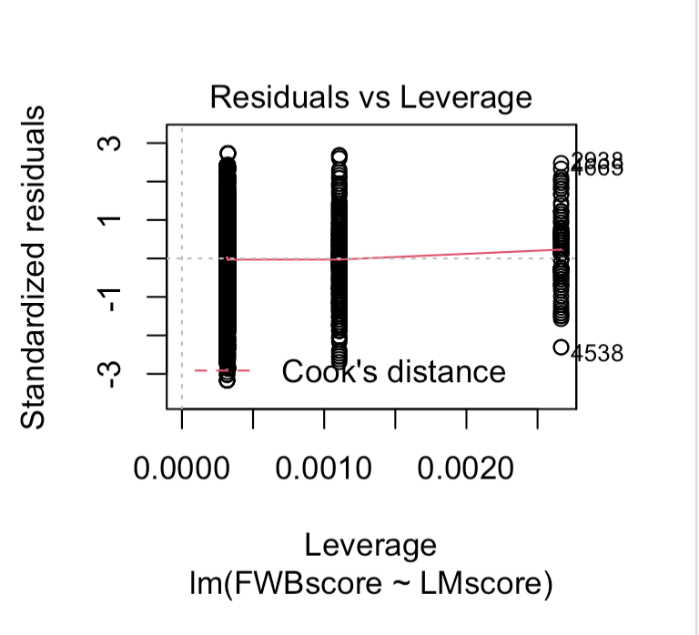
LMSCORE vs. FWBSCORE

Slide 34
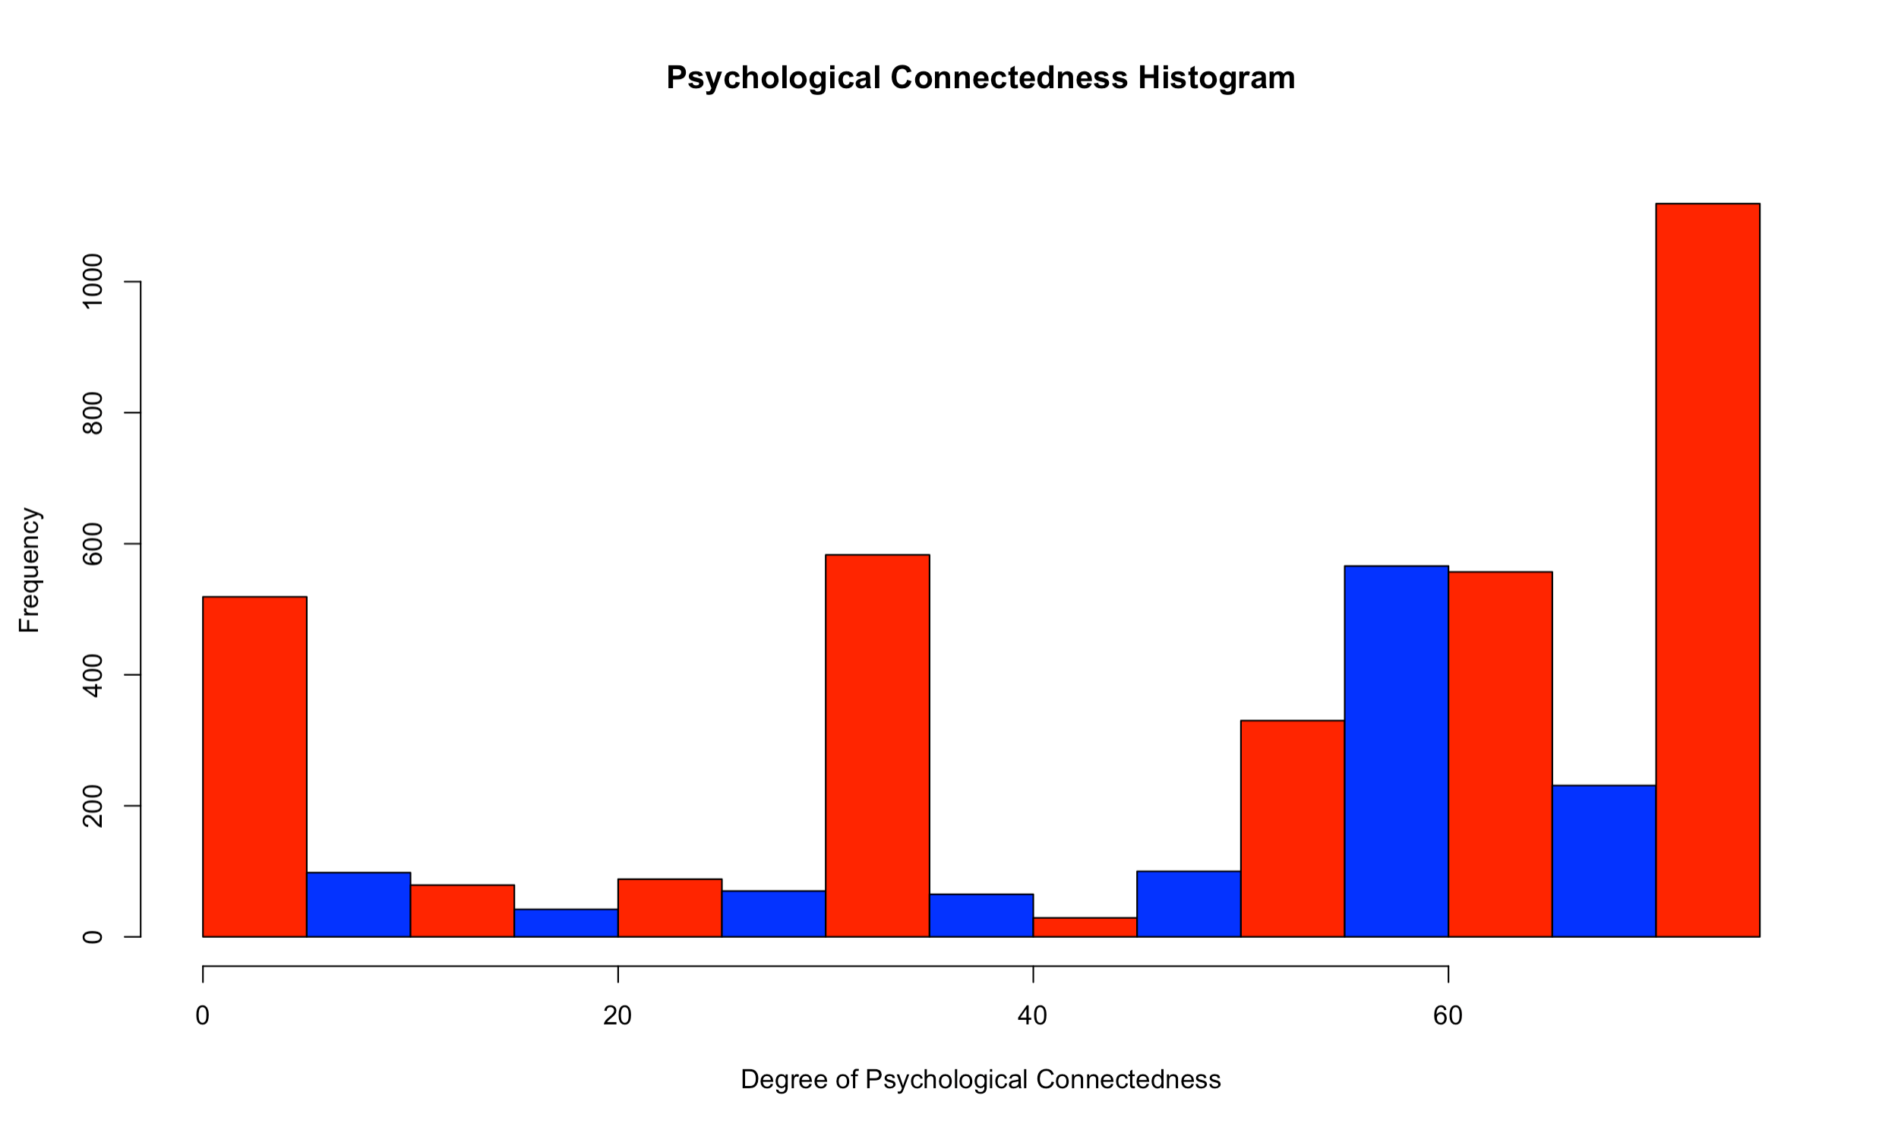
PSYCONNECT
Skewness | -0.7232388
Kurtosis | 2.19585

Slide 35
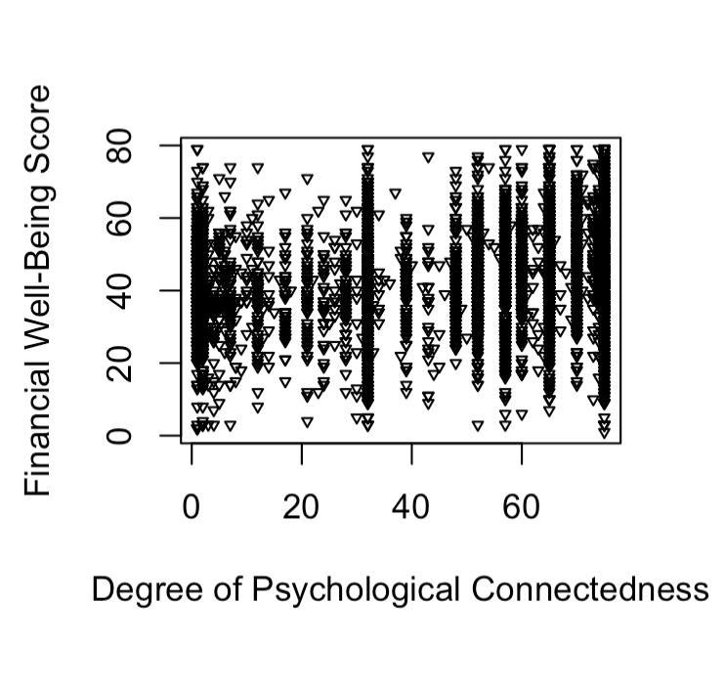
PSYCONNECT vs. FWBSCORE

Slide 36
PSYCONNECT vs. FWBSCORE
Name | Value
R | 0.2307611
Min | 0
1st Quartile | 2
Median | 3
Mean | 2.508
3rd Quartile | 3
Max | 3
Standard Deviation | 0.7585257

Slide 37
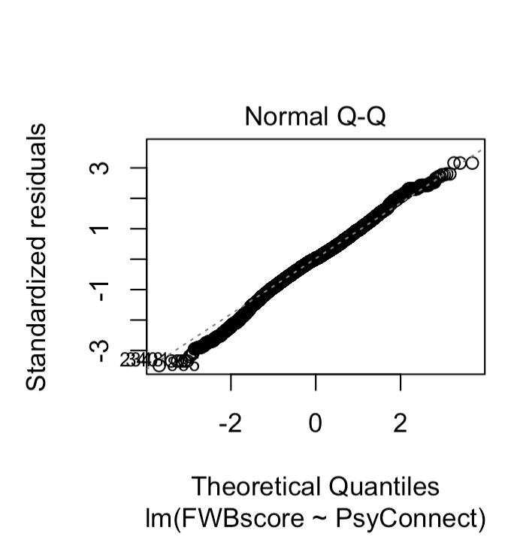
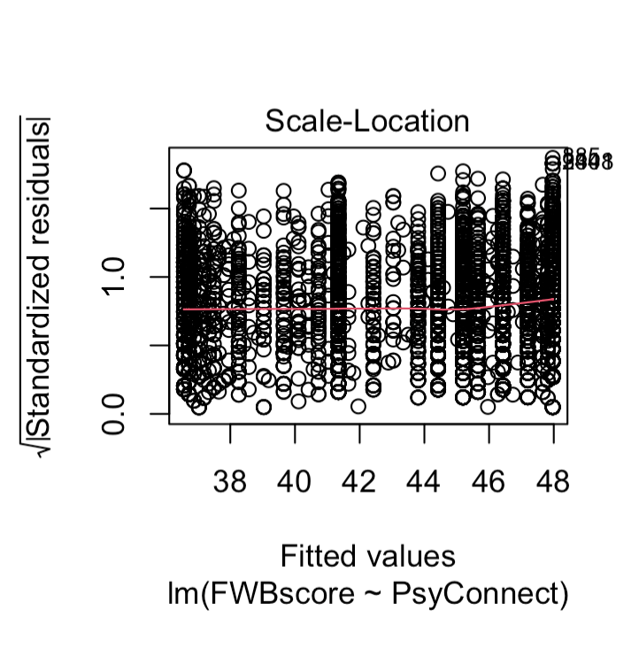
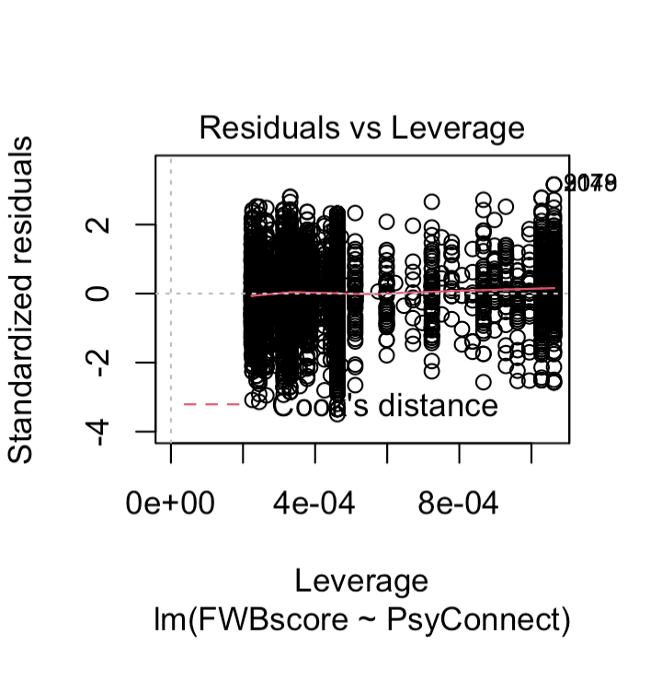
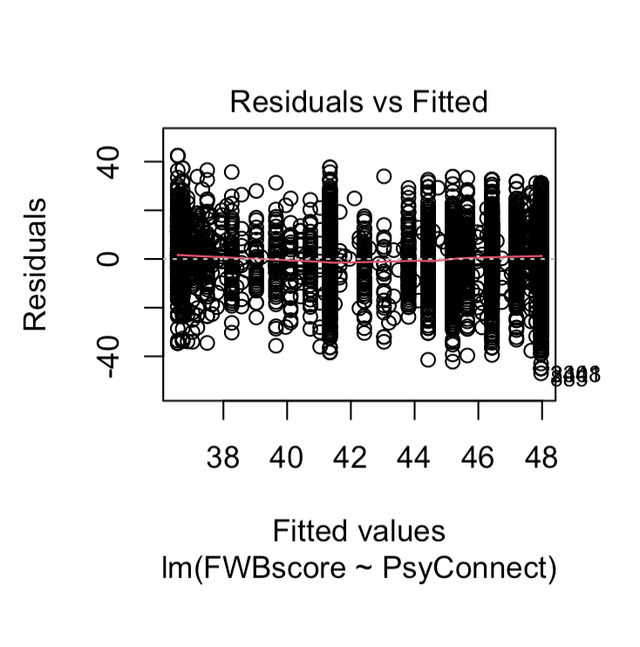
Psyconnect vS FWBSCORE

Slide 38
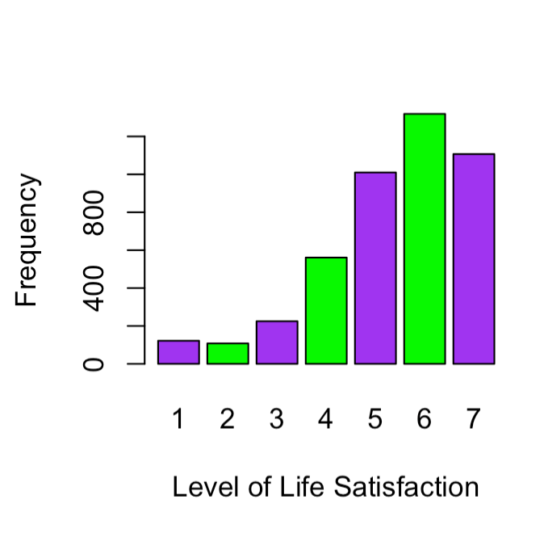
SATISFACTION
Skewness | -0.1687449
Kurtosis | 1.354938

Slide 39
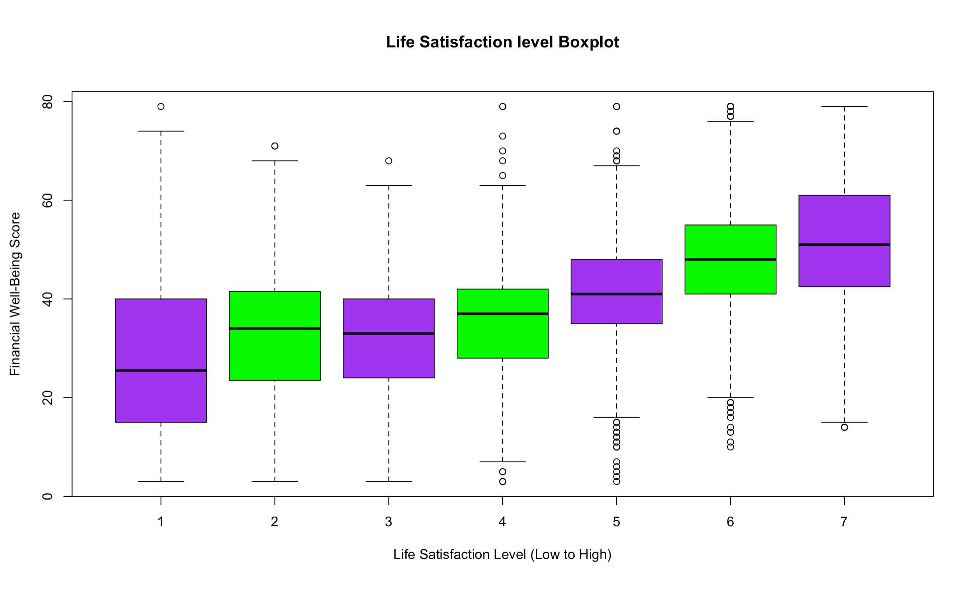
Satisfaction vs FWBSCORE

Slide 40
SATISFACTION vs. FWBSCORE
RESPONSE | MIN | 1st quartile | median | 3rd quartile | max
1 Strongly Disagree | 3 | 15 | 25.5 | 40 | 79
2 | 3 | 23.5 | 34 | 41.5 | 71
3 | 3 | 24 | 33 | 40 | 68
4 | 3 | 28 | 37 | 42 | 79
5 | 3 | 35 | 41 | 48 | 79
6 | 10 | 41 | 48 | 55 | 79
7 Strongly Agree | 14 | 42.5 | 51 | 61 | 79

Slide 41
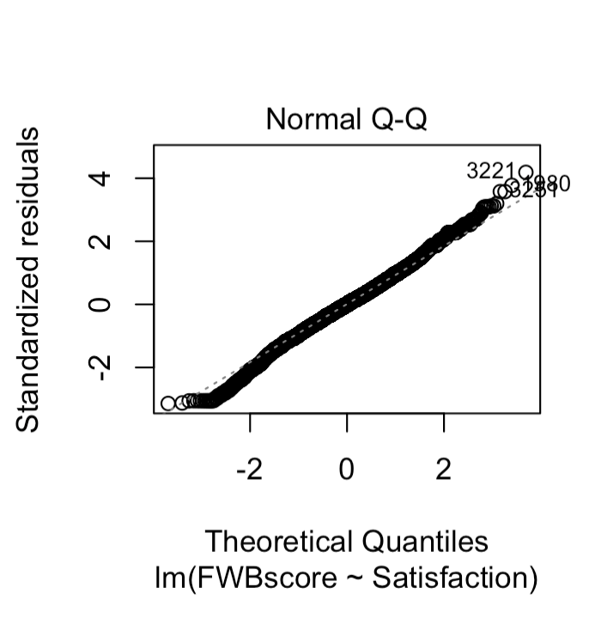
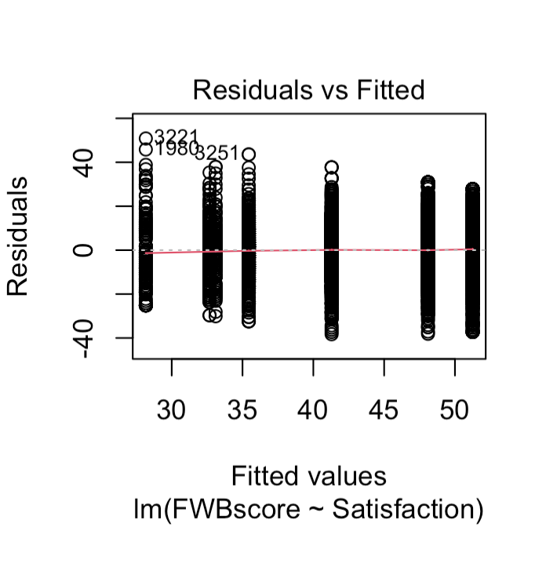
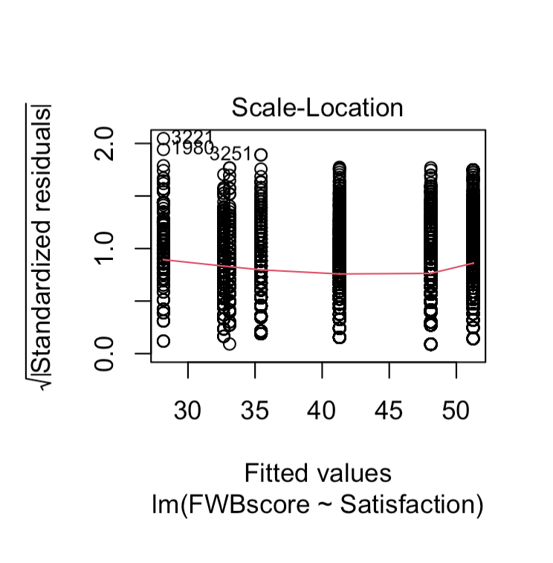
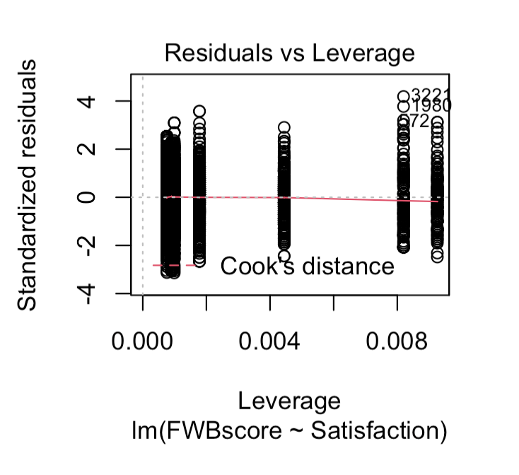
Satisfaction vs fwbscore

Slide 42
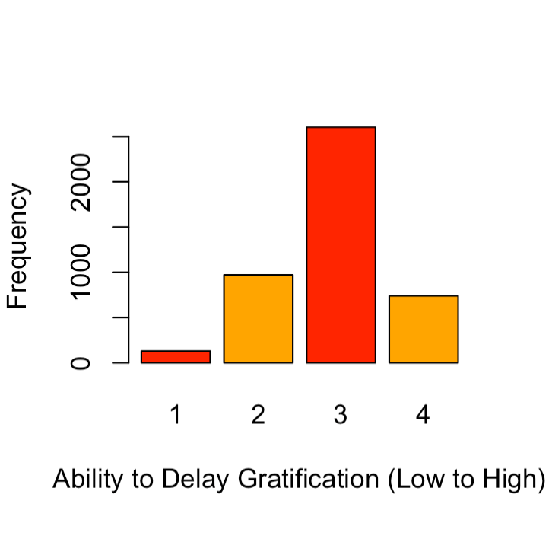
DELAYGRAT
Skewness | 0.760227
Kurtosis | 2.107598

Slide 43
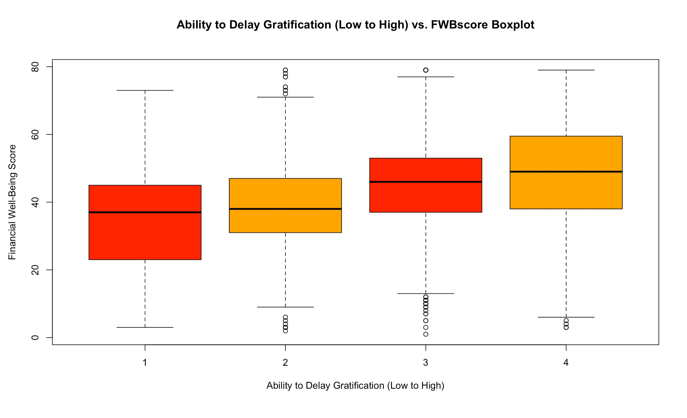
DELAYGRAT vS FWBSCORE

Slide 44
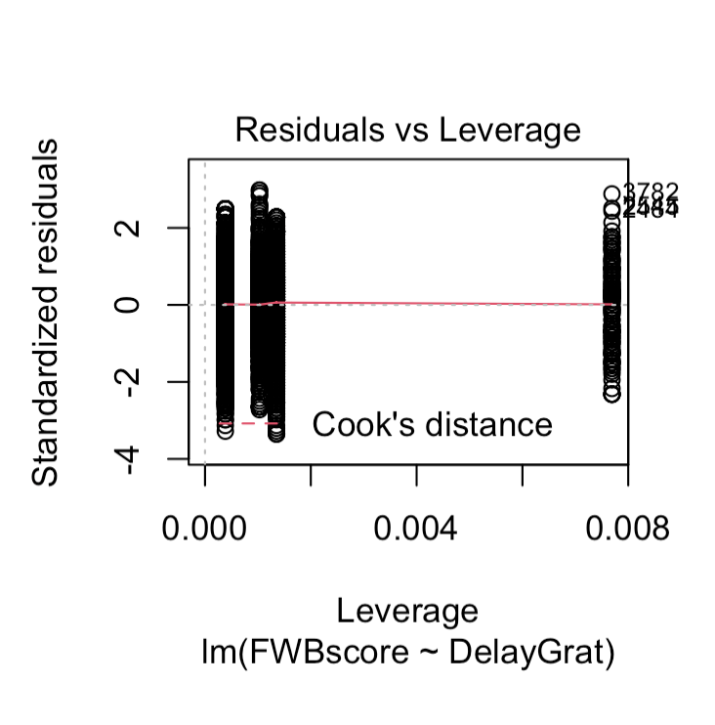
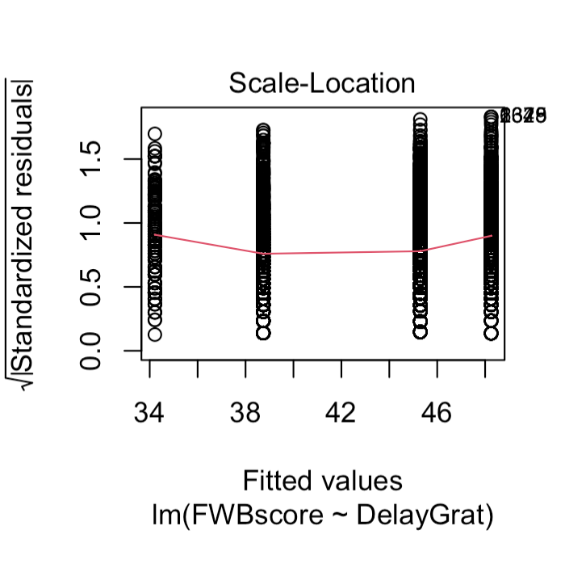
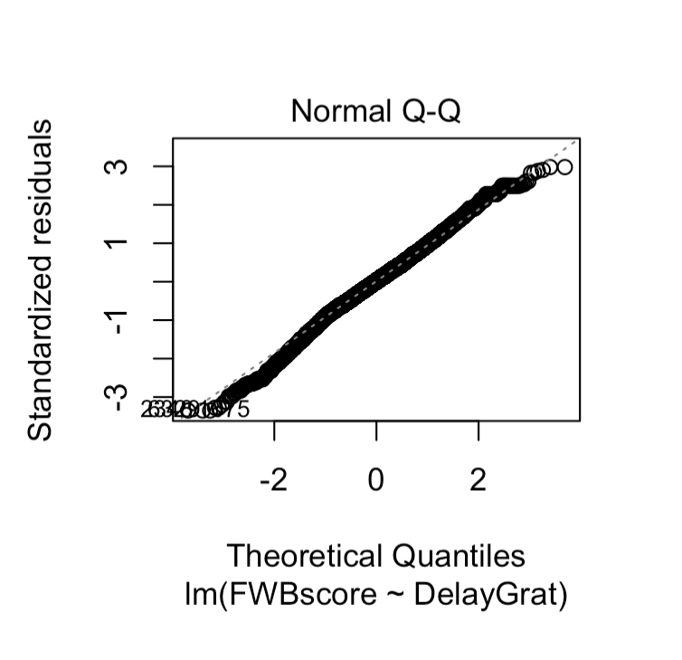
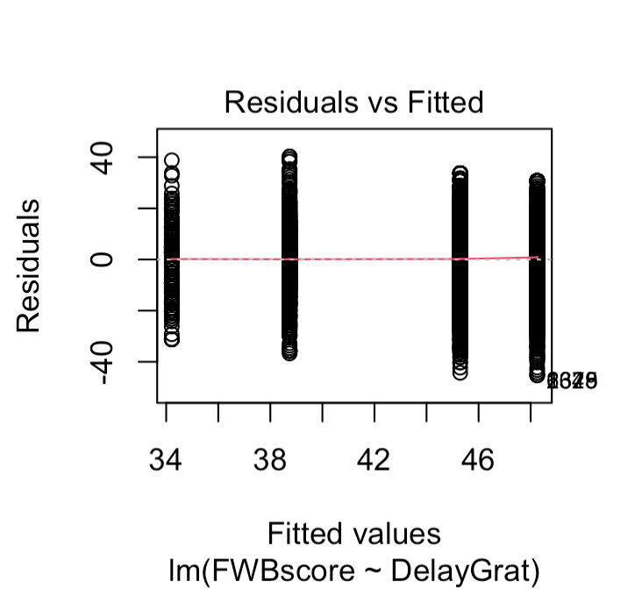
DELAYGRAT vs fwbscore

Slide 45
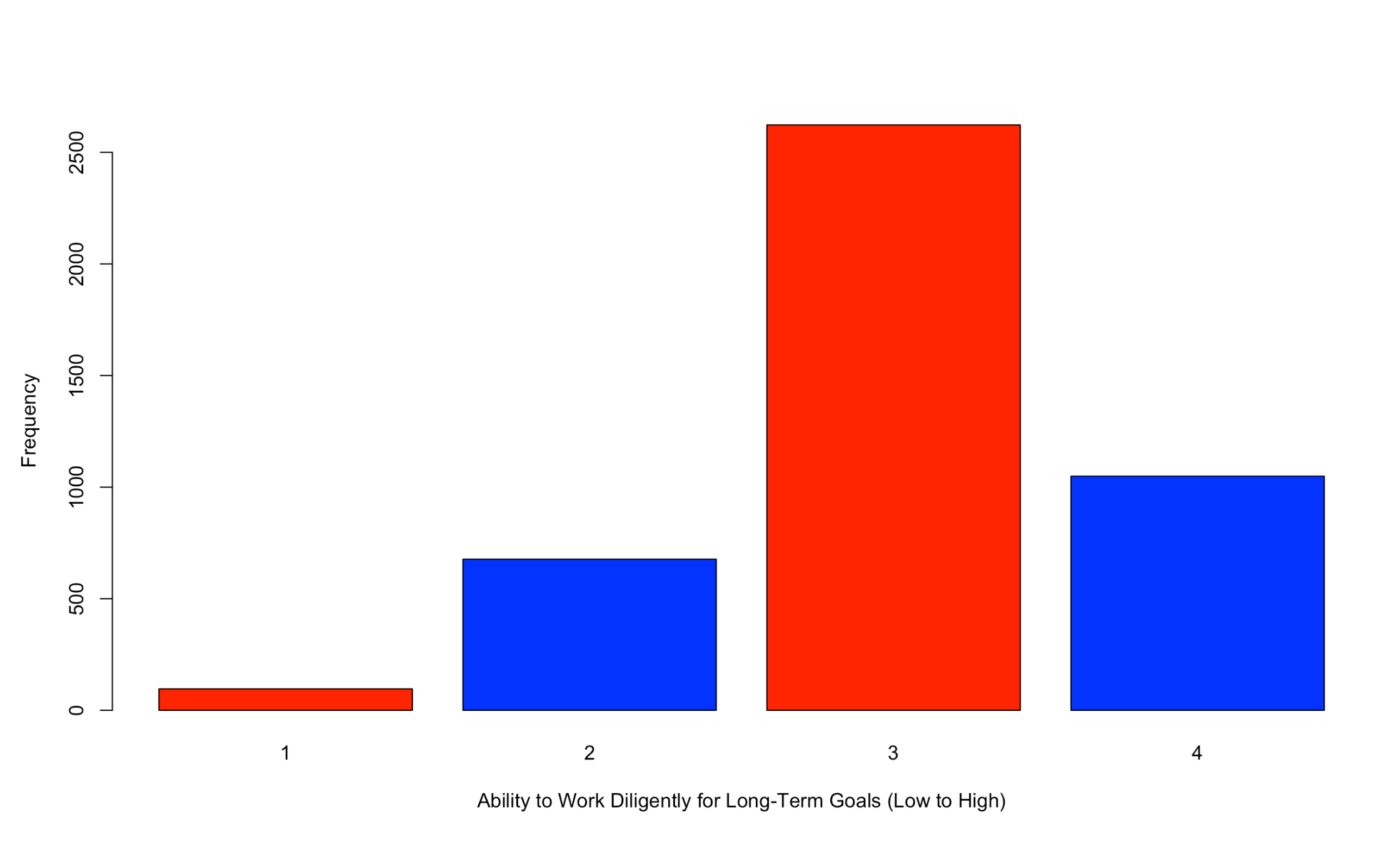
DILIGENCE
Skewness | 0.7079637
Kurtosis | 2.053925

Slide 46
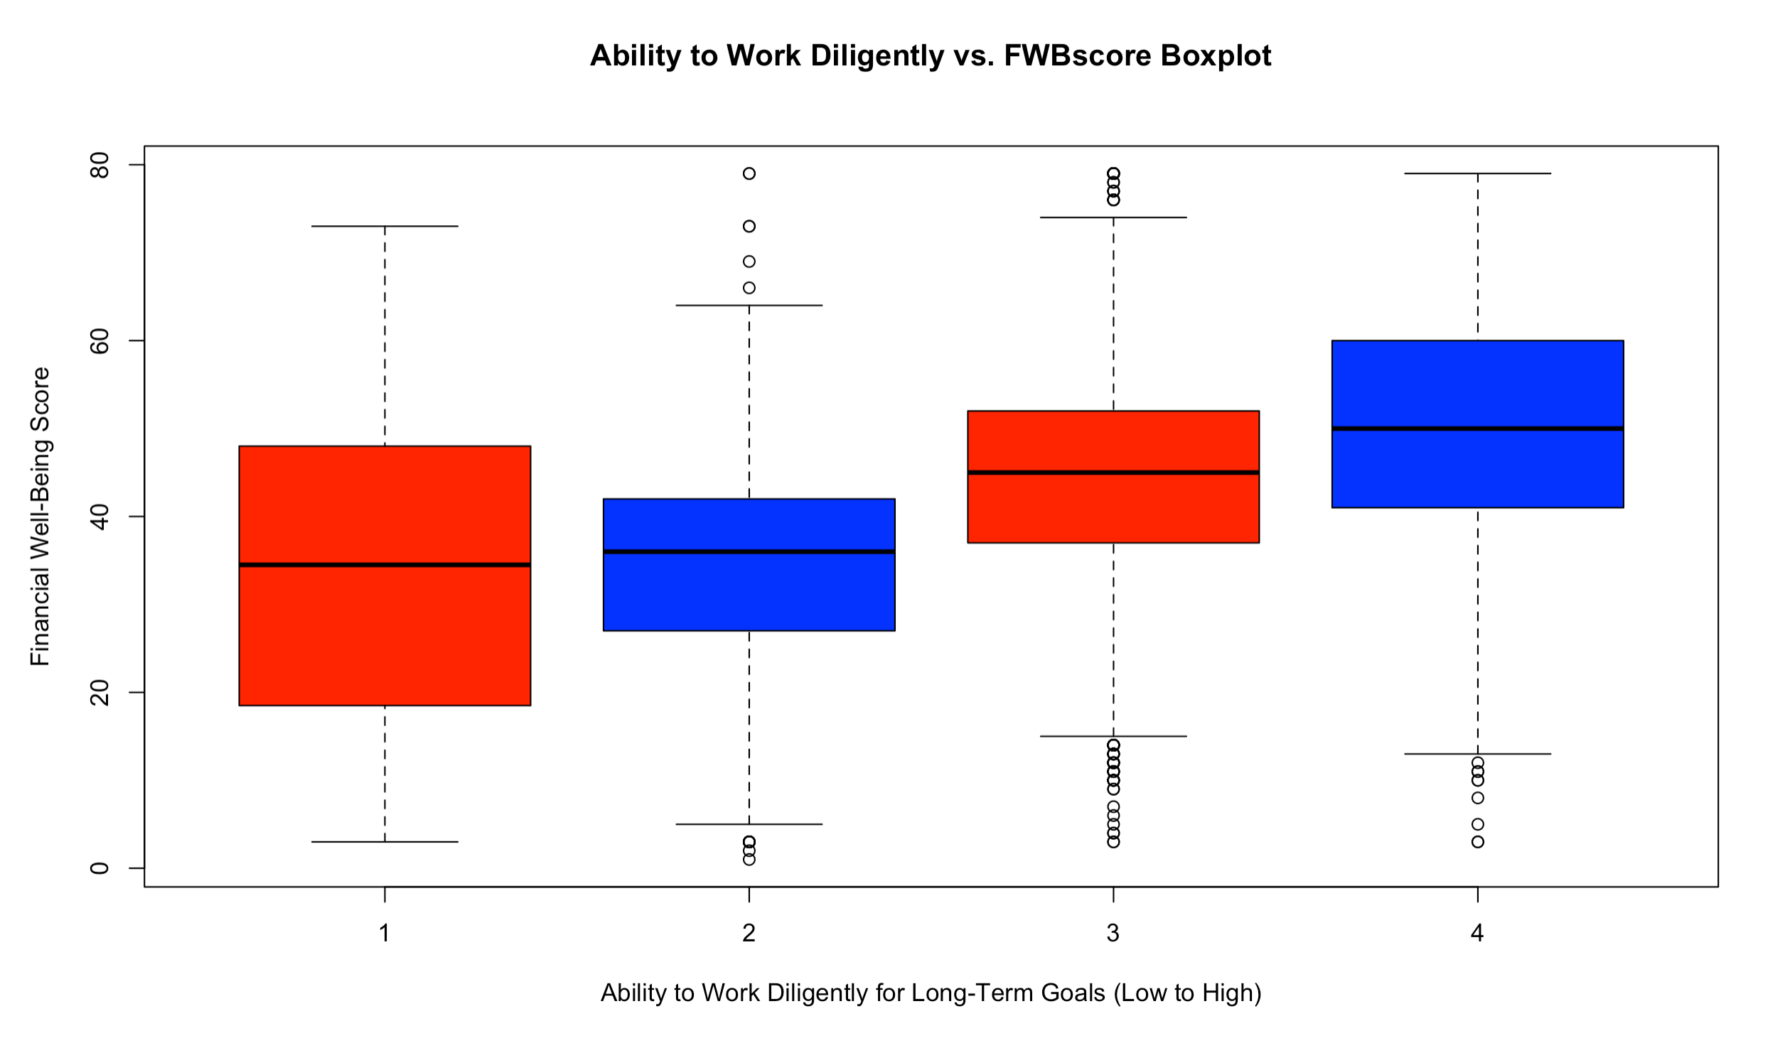
DILIGENCE vs fwbscore

Slide 47
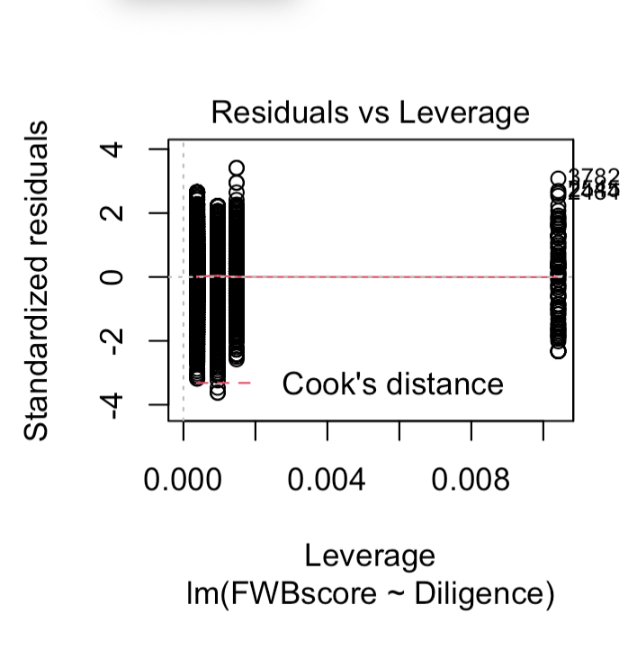
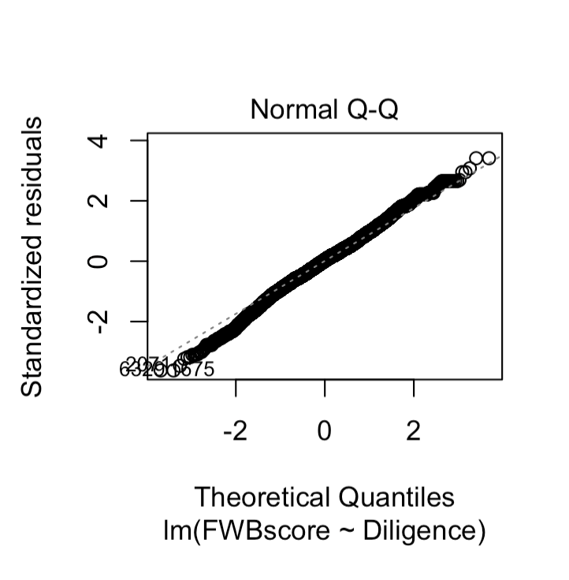
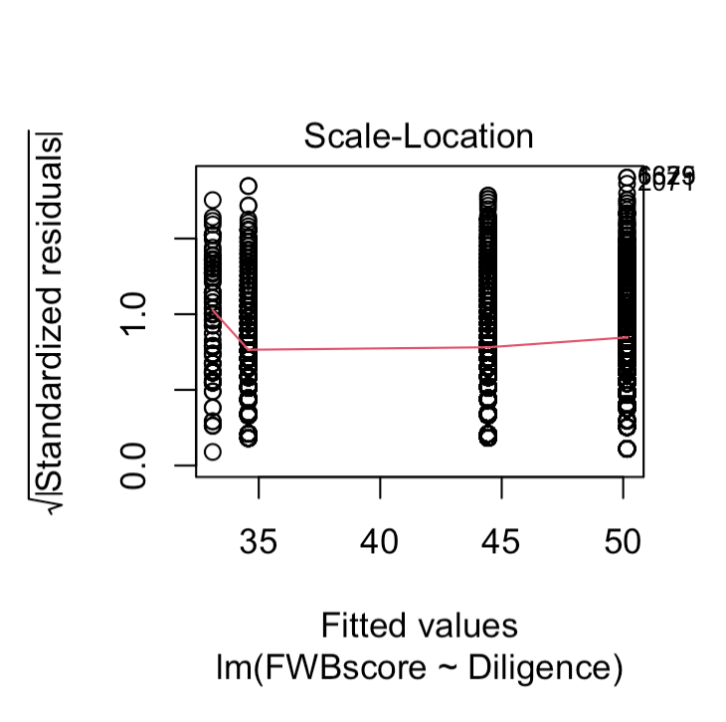
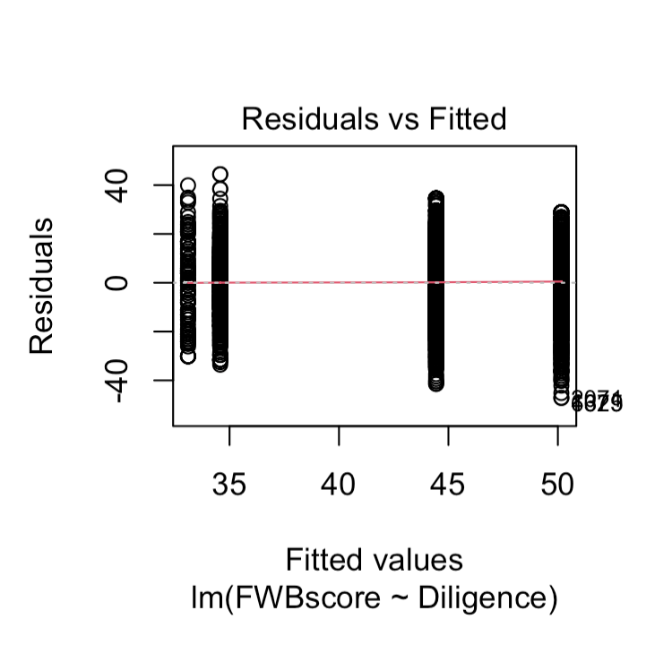
DILIGENCE vs fwbscore

Slide 48
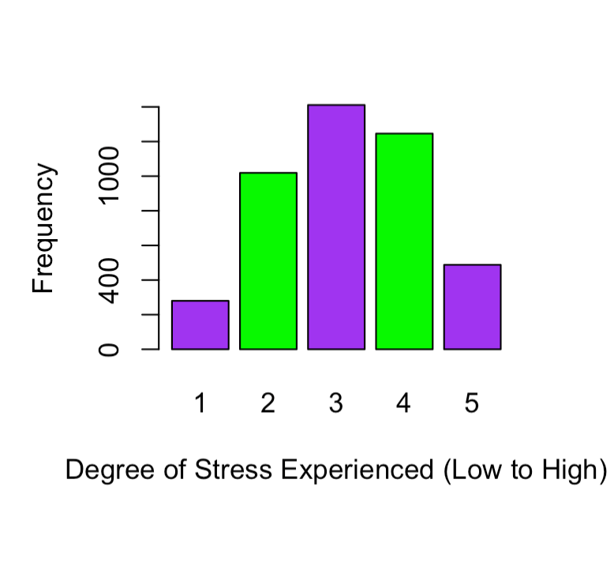
DIstrEss
Skewness | -0.2416841
Kurtosis | 1.412201

Slide 49
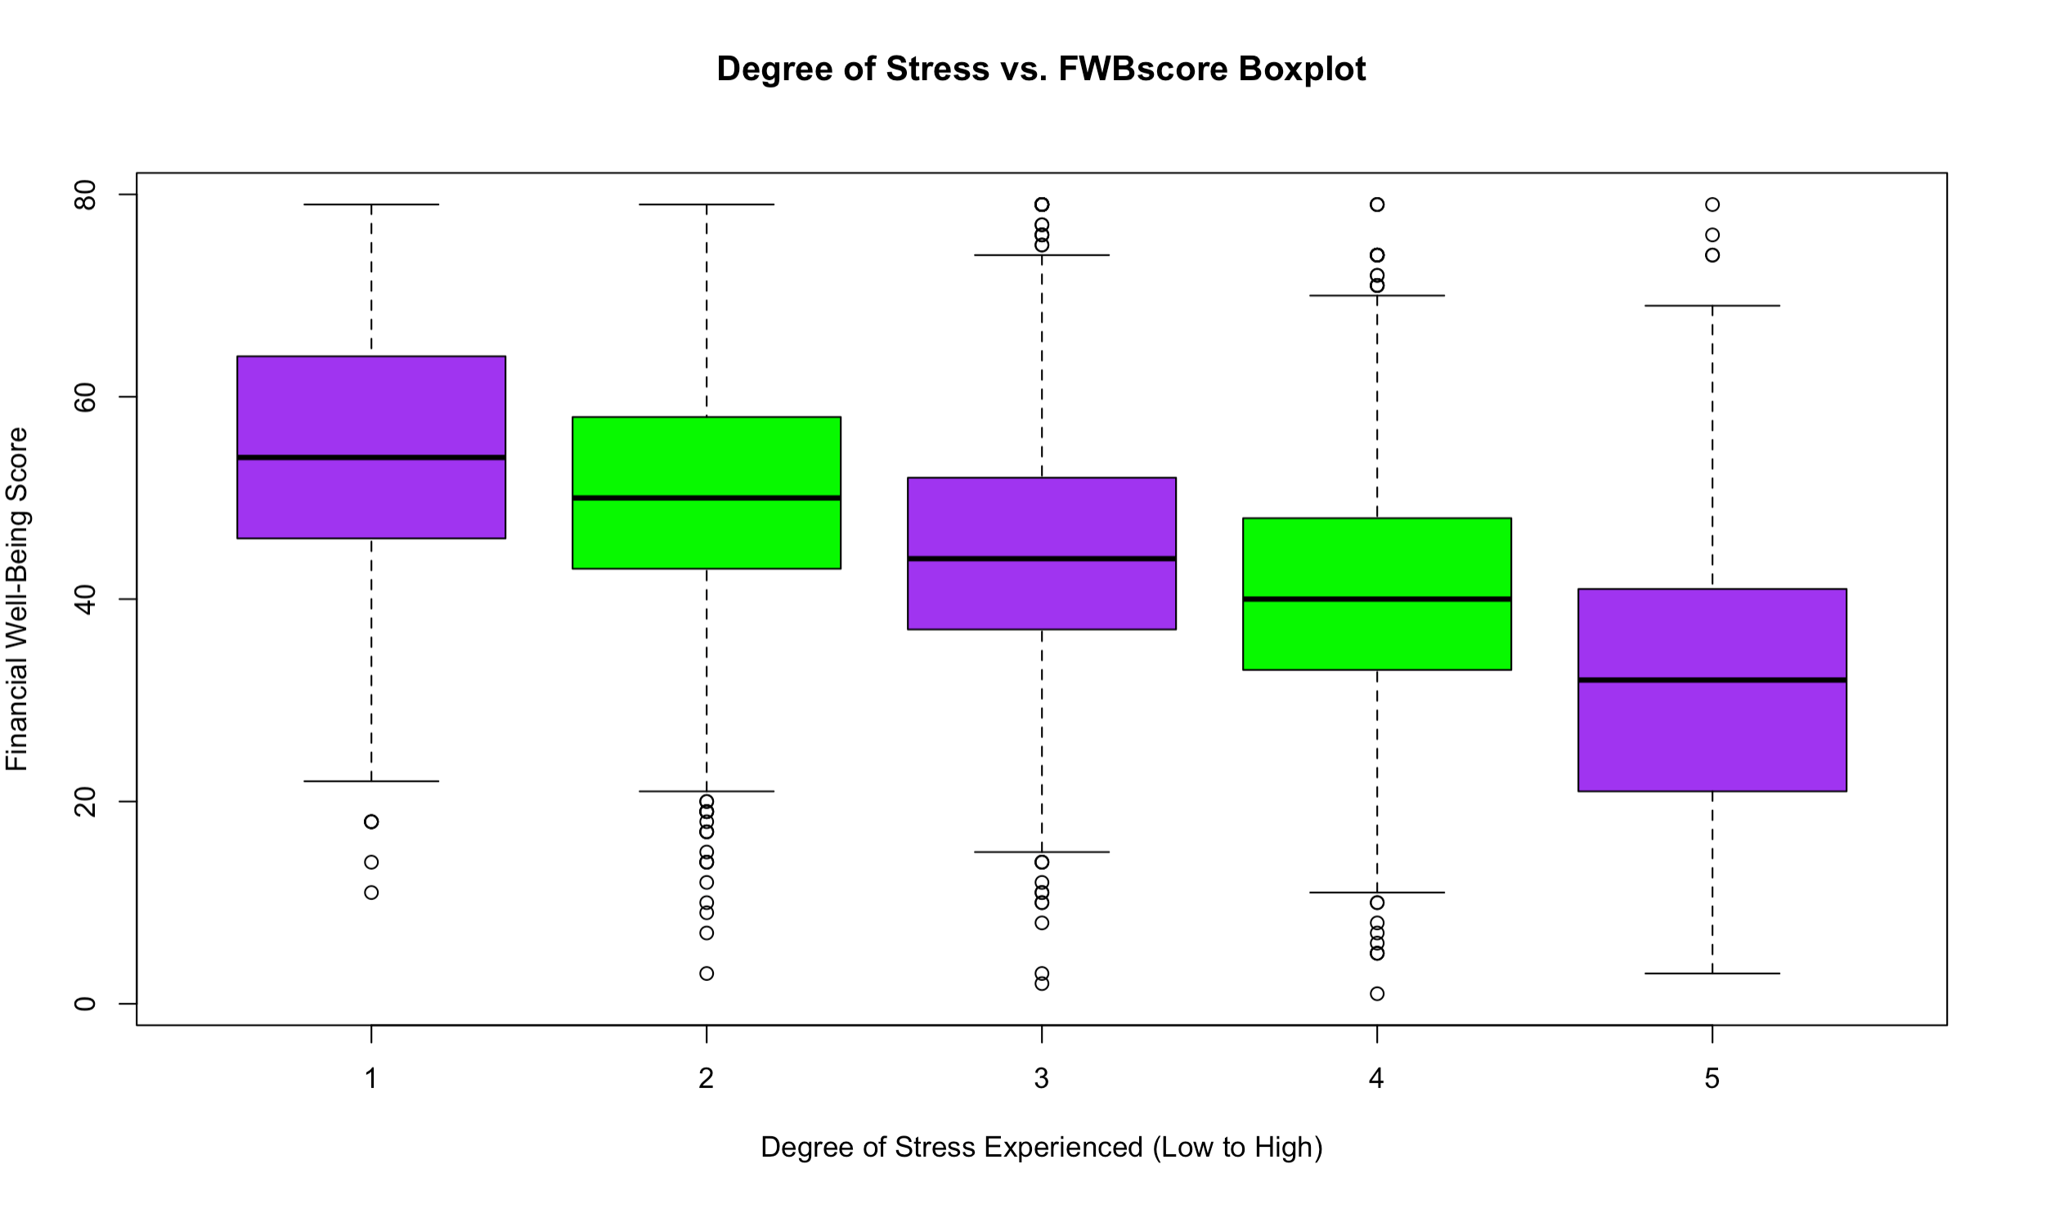
DISTRESS vs FWBSCORE

Slide 50
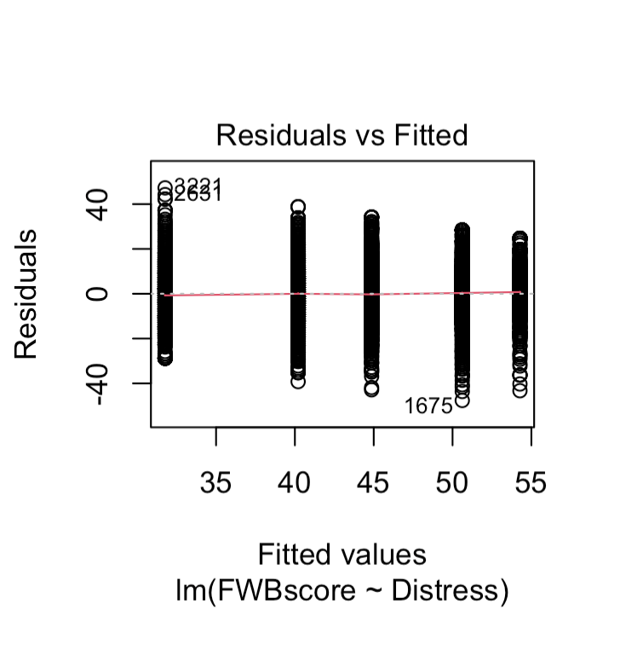
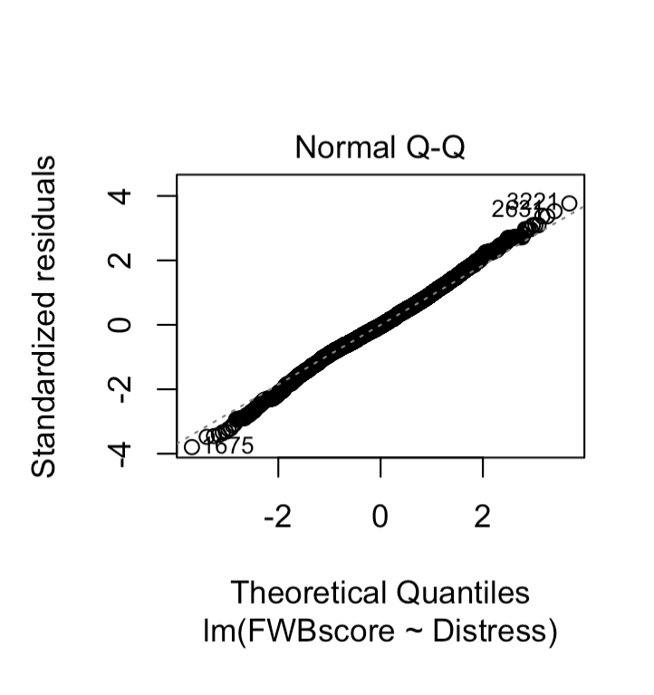
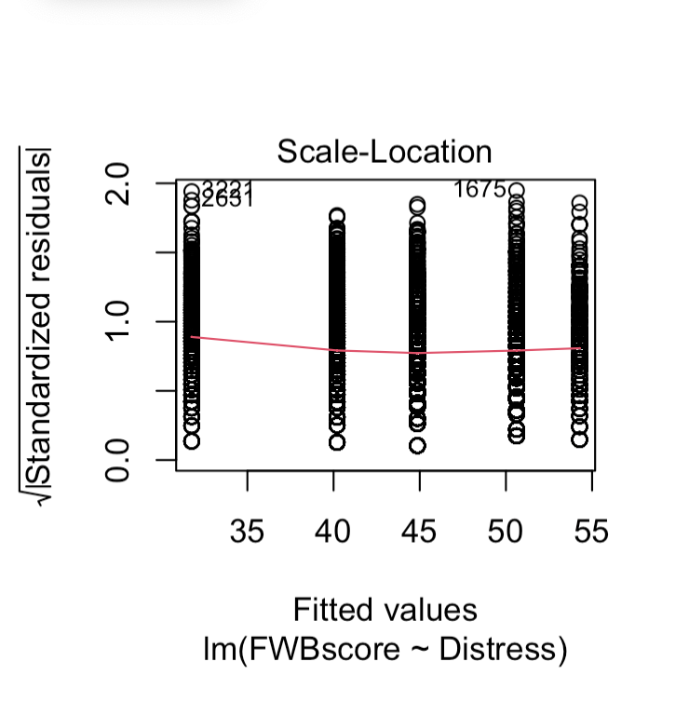
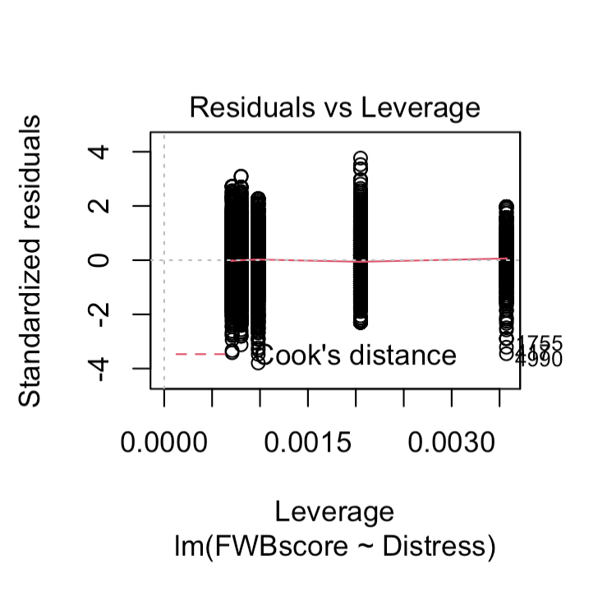
DISTRESS vs FWBSCORE

Slide 51
The final model ASSUMPTIONS CHECK

Slide 52
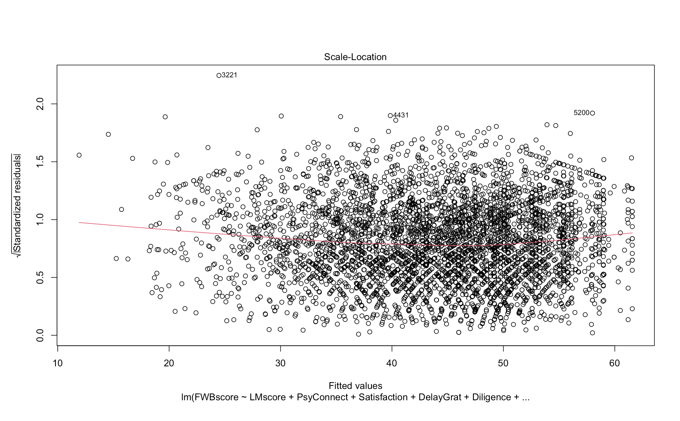

Slide 53
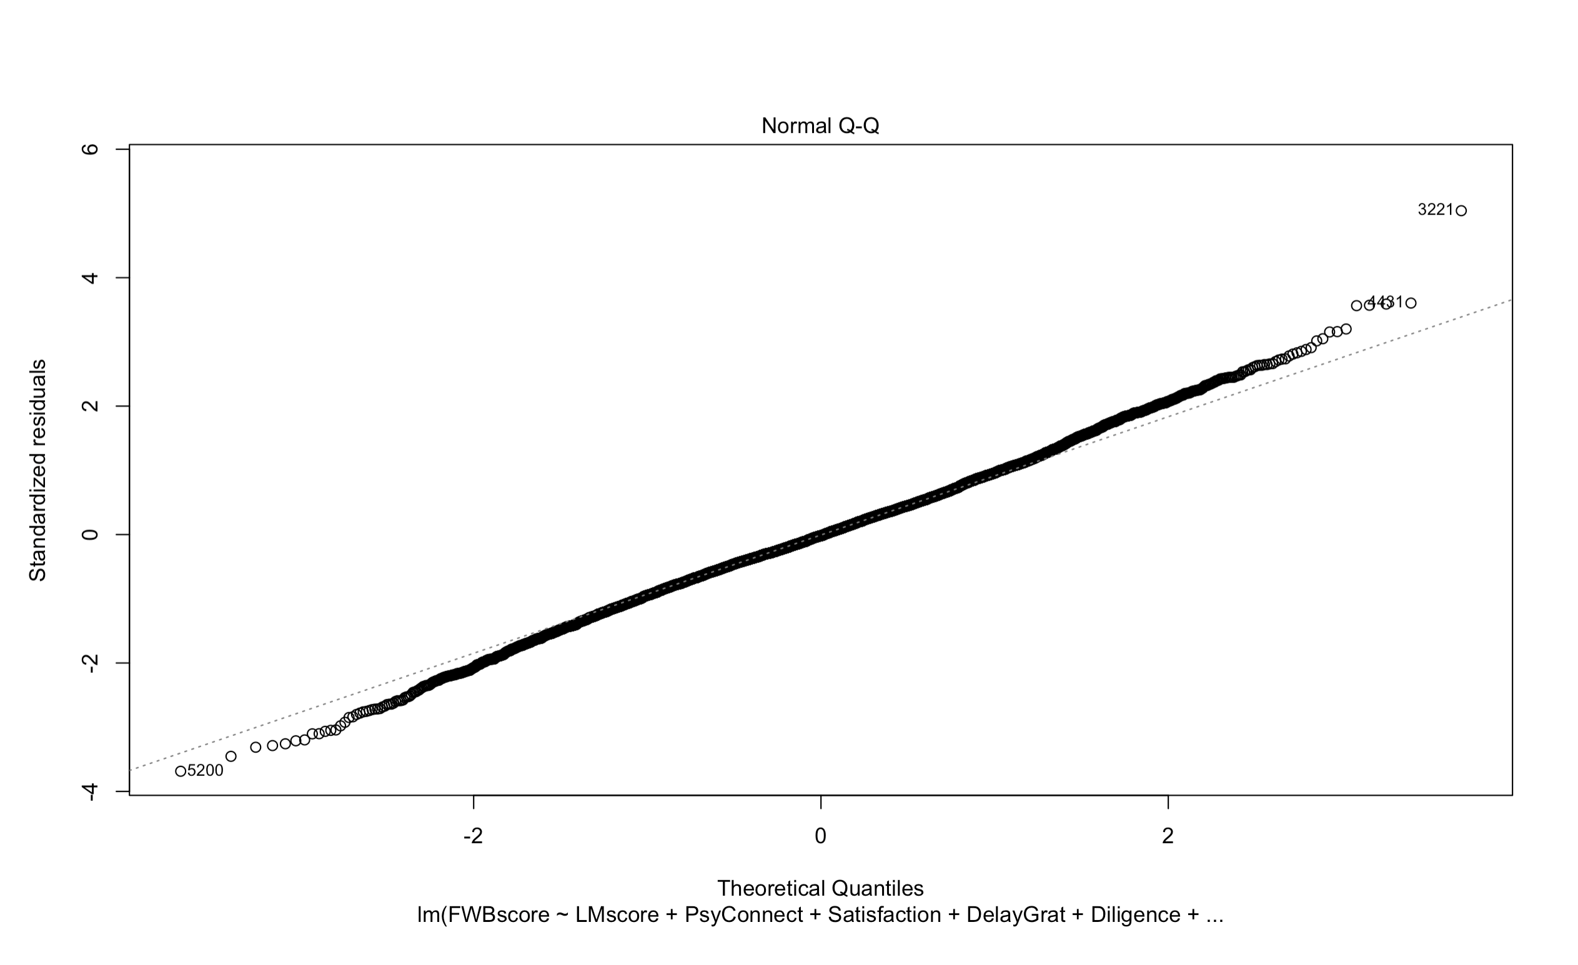

Slide 54
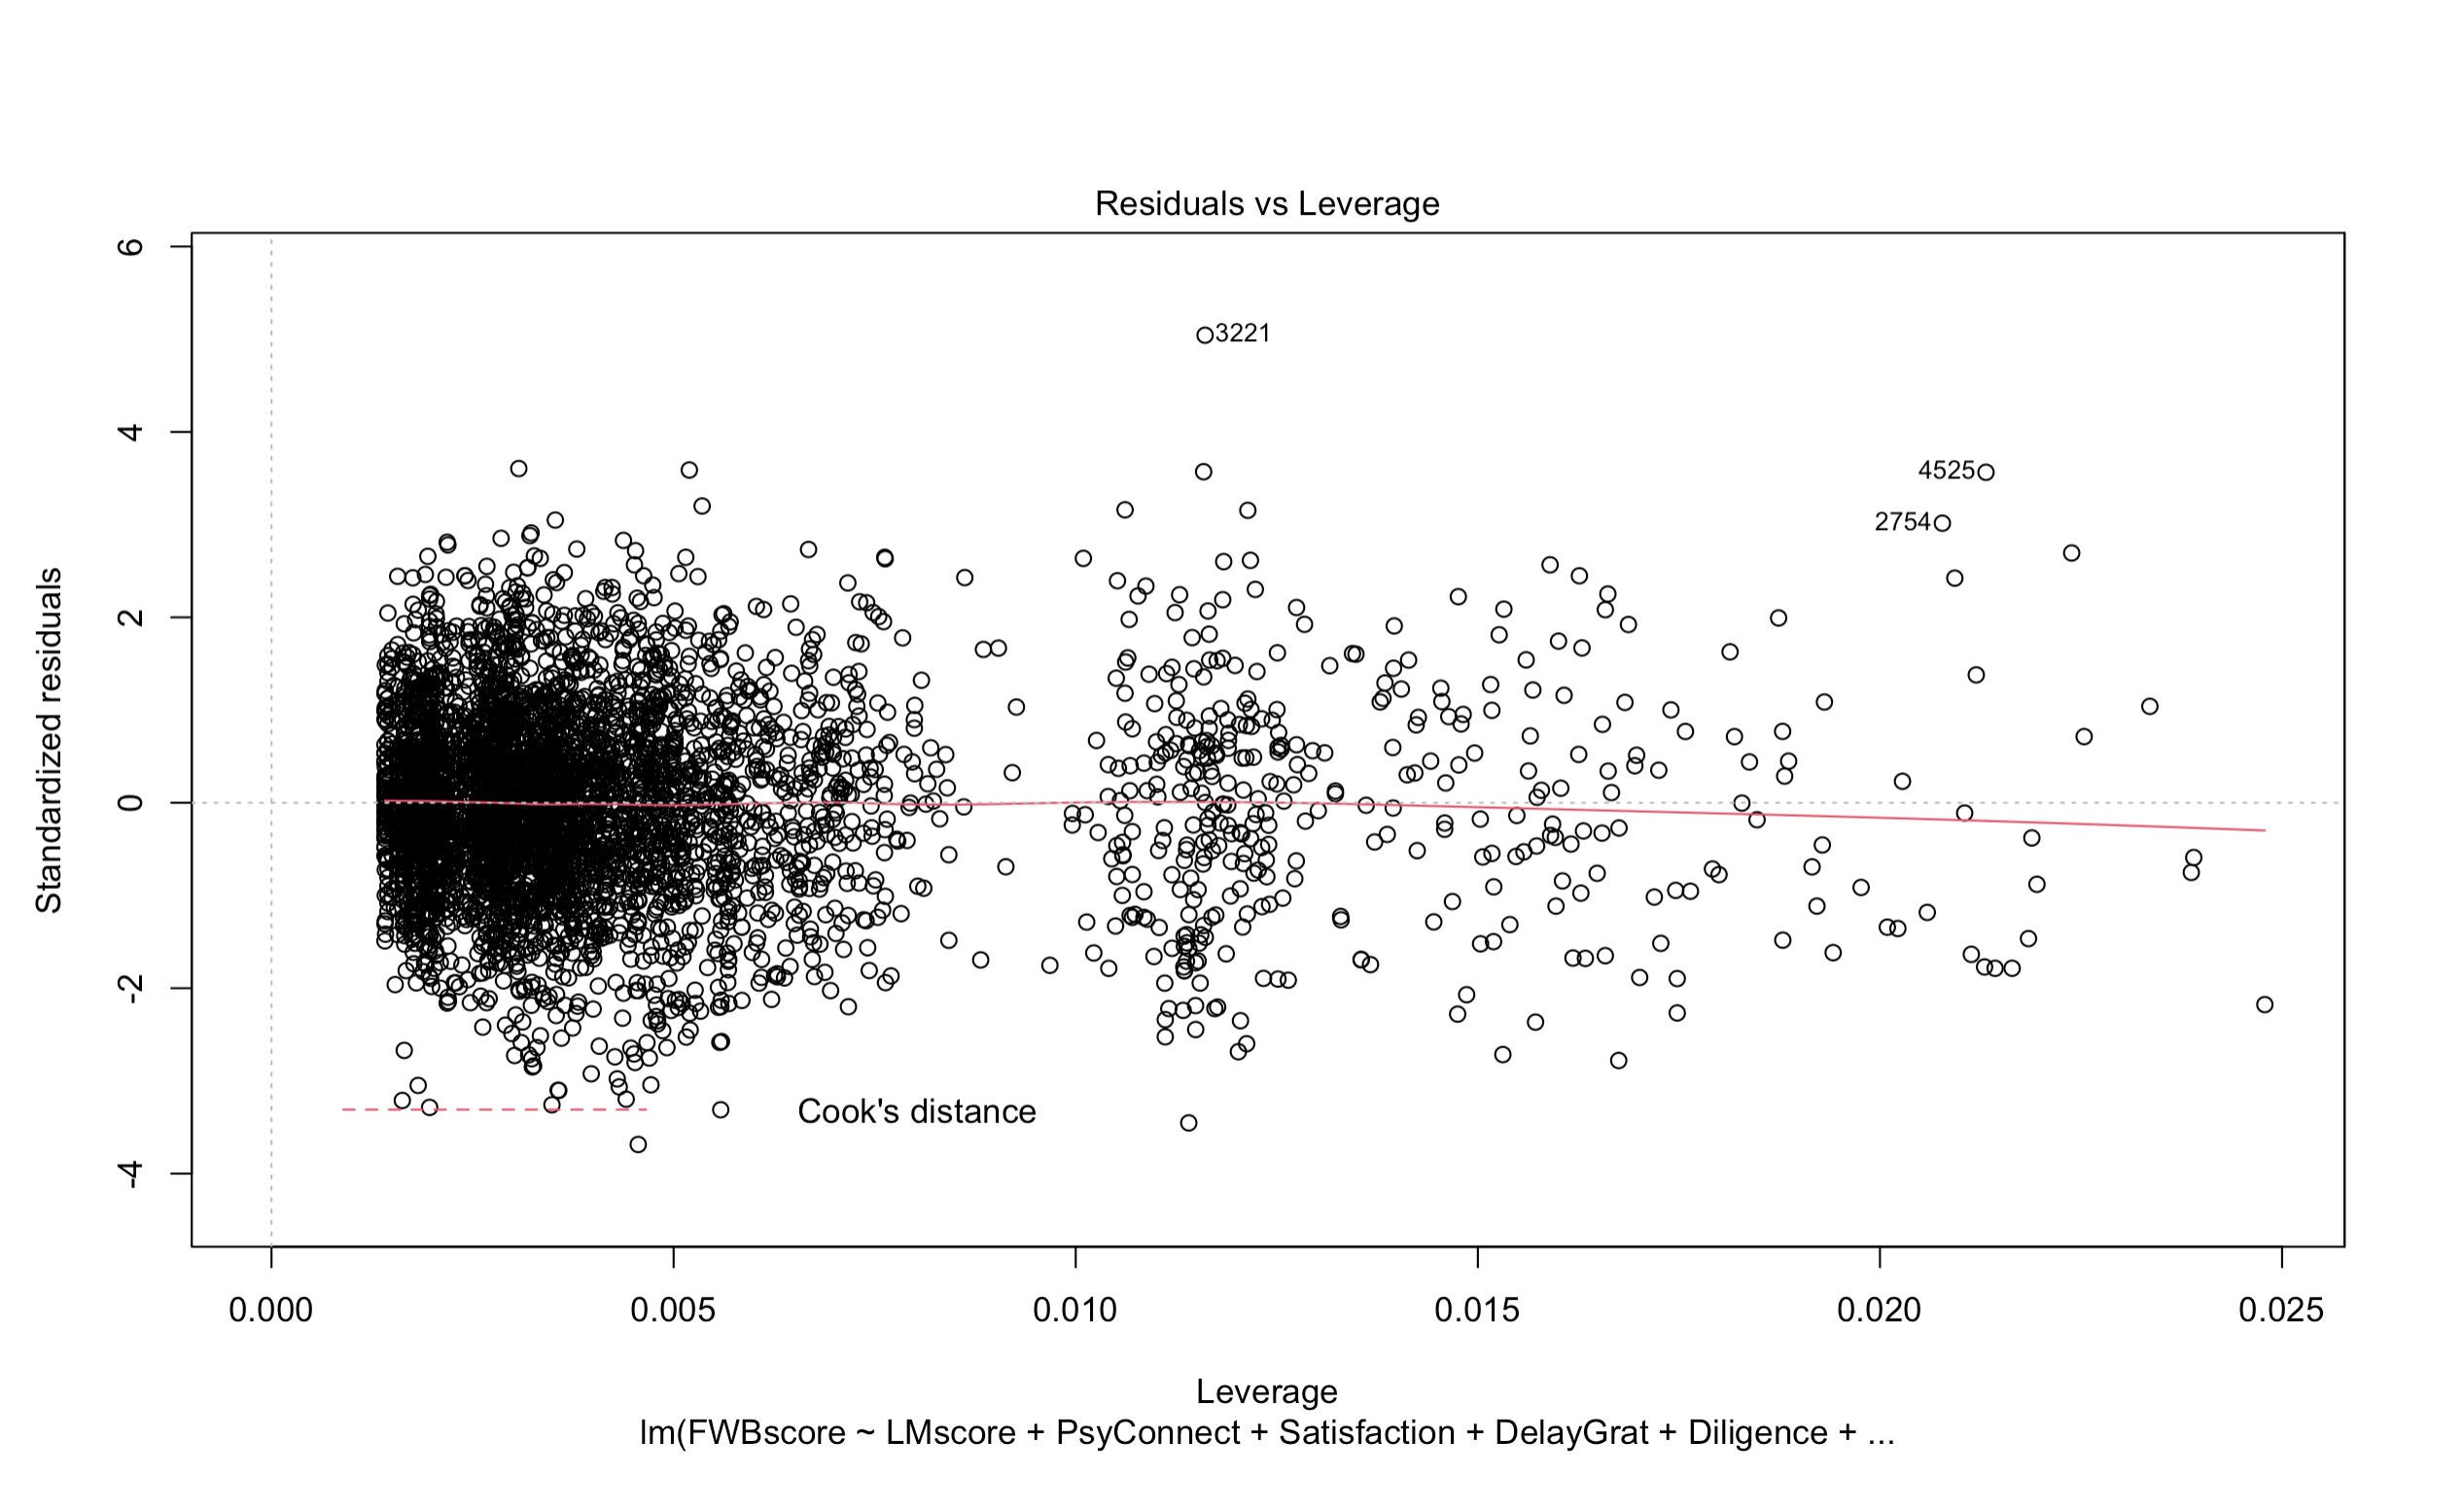

Slide 55
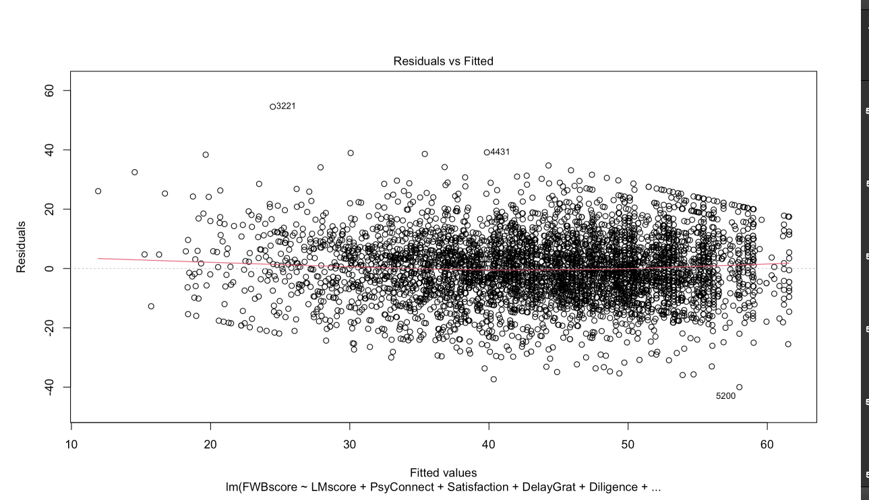

Slide 56
The formula:
final_model <- lm(FWBscore ~ LMscore + PsyConnect + Satisfaction + DelayGrat + Diligence + Distress, data = training.set)

Slide 57
REGRESSION & INFERENCE ANALYSIS

Slide 58
Variables | Coefficients | Std. Error | t-value | P-value
(Intercept) | 22.737070 | 1.749358 | 12.997 | < 2e-16
LMscore | 2.553433 | 0.232777 | 10.969 | < 2e-16
PsyConnect | 0.069884 | 0.007025 | 9.948 | < 2e-16
Satisfaction2 | 4.624614 | 1.452652 | 3.184 | 0.001465
Satisfaction3 | 4.352804 | 1.245364 | 3.495 | 0.000478
Satisfaction4 | 5.318207 | 1.116169 | 4.765 | 1.95e-06
Satisfaction5 | 8.592522 | 1.082741 | 7.936 | 2.63e-15
Satisfaction6 | 12.704118 | 1.082493 | 11.736 | < 2e-16
Satisfaction7 | 14.821706 | 1.090184 | 13.596 | < 2e-16
DelayGrat Not Very Well | 1.044828 | 1.097680 | 0.952 | 0.341225

Slide 59
Variables | Coefficients | Std. Error | t-value | P-value
DelayGrat Very Well | 2.189832 | 1.076153 | 2.035 | 0.041924
DelayGrat Completely Well | 2.561532 | 1.147124 | 2.233 | 0.025599
Diligence Not very well | 0.780536 | 1.264411 | 0.617 | 0.537061
Diligence Very well | 5.344811 | 1.227194 | 4.355 | 1.36e-05
Diligence Completely Well | 8.548546 | 1.269524 | 6.734 | 1.87e-11
Distress Disagree | -2.595926 | 0.748532 | -3.468 | 0.000529
Distress Neither agree nor Disagree | -5.423345 | 0.740002 | -7.329 | 2.75e-13
Distress Agree | -8.638280 | 0.758657 | -11.386 | < 2e-16
Distress Strongly Agree | -13.438450 | 0.865933 | -15.519 | < 2e-16

Slide 60
FINAL MODEL CONFIDENCE INTERVAL
Variable | 2.5% | 97.5%
(Intercept) | 19.28531204 | 26.14495983
LMscore | 2.09423616 | 3.00700720
PsyConnect | 0.05603460 | 0.08358084
Satisfaction2 | 1.77406500 | 7.46986304
Satisfaction3 | 1.90834976 | 6.79138446
Satisfaction4 | 3.12739201 | 7.50385444
Satisfaction5 | 6.46822085 | 10.71360922
Satisfaction6 | 10.58195572 | 14.82636555
Satisfaction7 | 12.67973621 | 16.95433770

Slide 61
FINAL MODEL CONFIDENCE INTERVAL
Variable | 2.5% | 97.5%
DelayGrat Not Very Well | -1.10900144 | 3.19496179
DelayGrat Very Well | 0.07989509 | 4.29944624
DelayGrat Completely Well | 0.30140024 | 4.79941683
Diligence Not Very Well | -1.69906181 | 3.25864424
Diligence Very Well | 2.93986289 | 7.75164085
Diligence Completely Well | 6.05623038 | 11.03400002
Distress Disagree | -4.02636805 | -1.08784884
Distress Neither Agree nor Disagree | -6.83889863 | -3.93414664
Distress Agree | -10.09023768 | -7.11239559
Distress Strongly Agree | -15.10087094 | -11.70285246

Slide 62
FINAL MODEL SUMMARY
Data Type | Values
Degrees of Freedom | 4392
Residual Standard Error | 10.88
Multiple R² | 0.3927
Adjusted R² | 0.3902
F-Statistic | 157.8
P-Value | < 2.2e-16

Slide 63
Practical significance
Schools / Universities might be able to educate students or understand their own financial well-being at better level by taking into account the variables at hand. Given delaying gratification and diligence, teachers as well as parents can play the long game in teaching their students to hone the traits of an individual who is correlated to have a high financial well-being. Individuals themselves can also go about using this data in a personal development manner by working to increase their self control traits, financial knowledge, increase their attitude of life satisfaction, boost their perceived connection to their future self and lower stress to create the greatest correlated influence on ones financial well-being score.

Slide 64
Insights I walked away with
The overall results were drastically different then anticipated, variables used and the impact of certain variables over others. However, the variables that were influential were anticipated as I never had to transform the data, nor did I need to reframe the research question or collection of variables (besides variable removal for parsimoniousness).
I realized that while self control and financial knowledge are clear influential variables upon my own financial well-being, so are the more unperceived variables of psychological connectedness, life satisfaction, and stress. I have already taken action to increase my financial knowledge consistently and boost my self control but now I will be doing more. By lowering my stress levels, connection to my future self, and overall life attitude, I hope to increase my financial well-being in the long run.

Slide 65
Work Cited
Garman, E. Thomas, and Benoit Sorhaindo. “Delphi Study of Experts’ Rankings of Personal Finance Concepts Important in the Development of the InCharge Financial Distress/Financial Well-Being Scale1.” Consumer Interest Annual, 2005.
https://www.consumerinterests.org/assets/docs/CIA/CIA2005/garman_delphistudyofexpertsrankingsofpersonalfinanceconcept.pdf
Strömbäck, Camilla, et al. “Does Self-Control Predict Financial Behavior and Financial Well-Being?” Journal of Behavioral and Experimental Finance, Elsevier, 5 May 2017
www.sciencedirect.com/science/article/pii/S2214635017300291?via=ihub
Younas, W., Javed, T., Kalimuthu, K., Farooq, M., Khalil-ur-Rehman, F., & Raju, V. (2019). Impact of Self-Control, Financial Literacy and Financial Behavior on Financial Well-Being. The Journal of Social Sciences Research, (51), 211-218. doi:10.32861/jssr.51.211.218
https://www.arpgweb.com/pdf-files/jssr5(1)211-218.pdf.
* This Work Cited was on behalf of the review of related work

